Slide 1
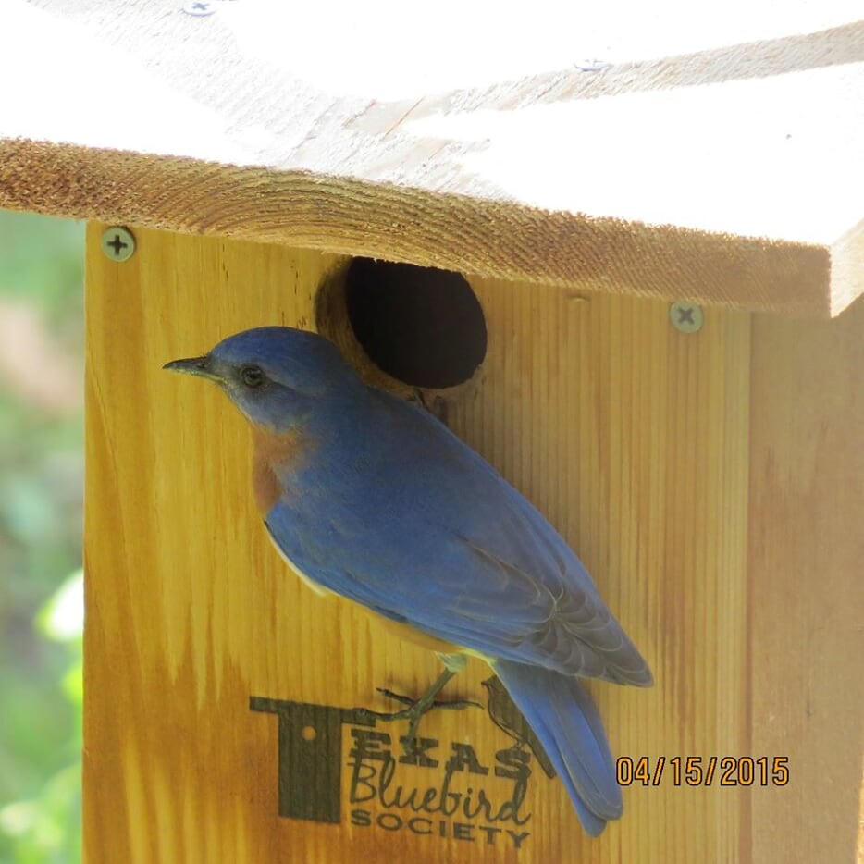
Bluebird Basics
Bluebird Basics
© Texas Bluebird Society
Basic presentation available at http://SHARE.txblues.org
© Texas Bluebird Society 2023
Last Updated: 8/18/23
Notes:
This presentation is brought to you by Texas Bluebird Society an all volunteer, non-profit organization that
Spreads “Bluebirds Across Texas … one nestbox at a time” – through education,; and, the installation of NestWatch’d nestboxes in appropriate habitat; and, sustaining and increasing their natural food supply (insects and berries of native plants) – while enjoying the process and the bluebirds” This is Mission Statement
No advertising budget – no paid officers or board – small amount paid for bookkeeping and web services – the vast majority of all funds received from memberships are used to purchase more lumber to build more nestboxes _ built by volunteers - over 20,000 official woodburned Texas Bluebird Society nestboxes since 2002 (2022 data)
This “shareable” basic presentation is available at http://SHARE.txblues.org

Slide 2
This presentation does not necessarily represent the views of the Texas Bluebird Society.
Notes:
NOTE TO SPEAKER: This slide and statement are REQUIRED, per TBS Board of Directors action (2008).
Presenter: please send word to Roberta_Marshall@msn.net with word you will be presenting and details of the presentation so we can calendar your presentation on our website. Afterwards, send word of how many (if any) join TBS..
Opening:
This is a presentation of Texas Bluebird Society. I’ve added some material and text – and, I’ll say things in my own way. For “official” words from Texas Bluebird Society, visit the website and read TBS publications.

Slide 3
The “Eastern Bluebird” account in “Birds of the World” (BOW), formerly known as “Birds of North America” (BNA) is our authoritative source for presentation details.
Photographers granted permission for use of their photos.
We are deeply grateful.
Notes:
Presenter: Watch for “BNA/BOW” in notes.
TBS has done extensive "fact checking" in an effort to be as accurate as possible with the information in this presentation To this end, we have consulted with world-respected experts in the field of Ornithology. We would like to express our endless gratitude to all those who have invested years, decades and even lifetimes in the research and study of all birds , but especially our beloved bluebird !
We are also grateful to photographers who give us permission to use their photographs in our presentations. Watch for the names of photographers embedded in photographs.

Slide 4
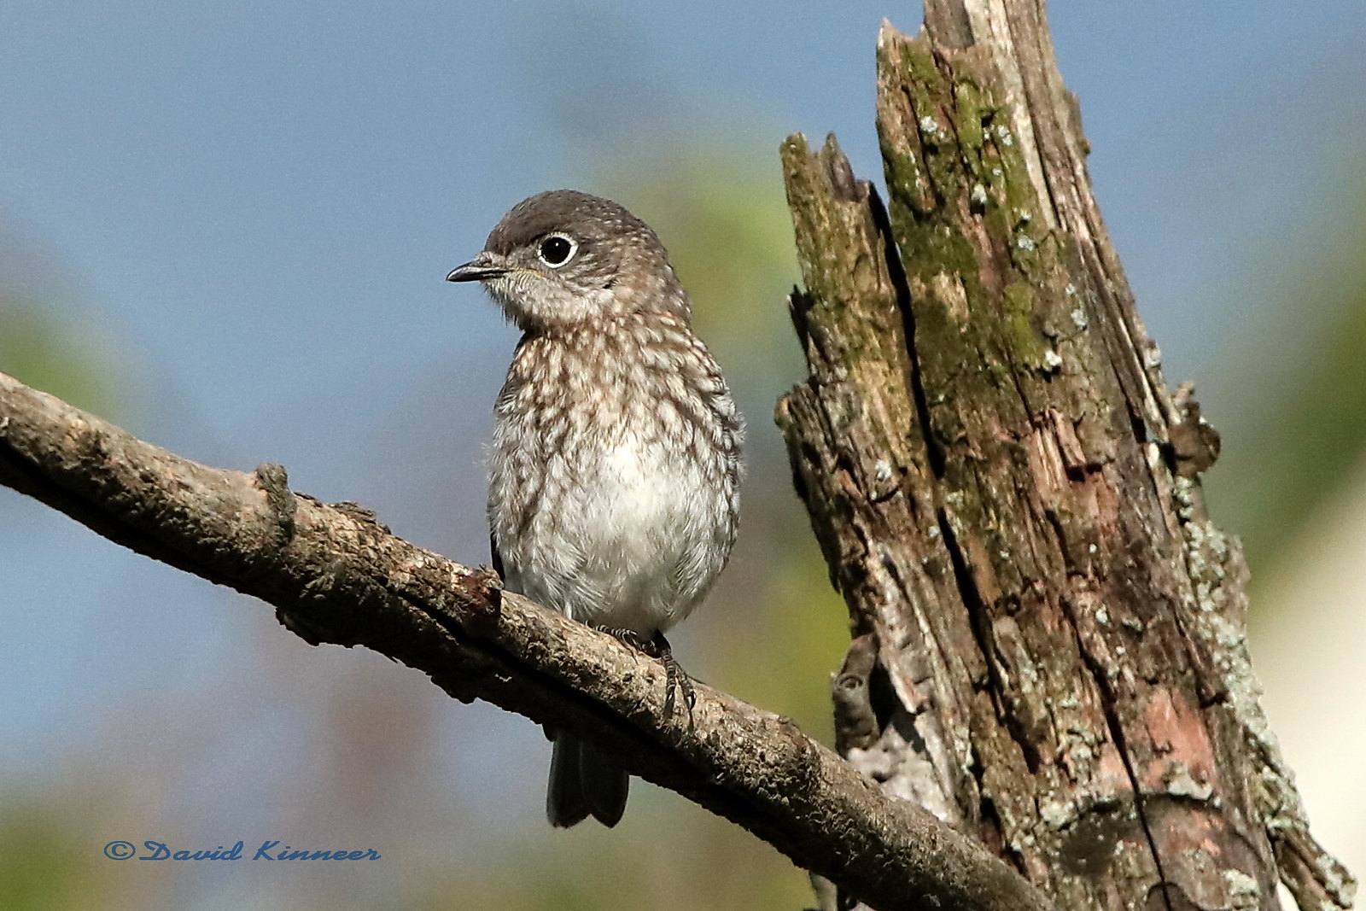
© Texas Bluebird Society
Notes:
Family: Turdidae – the Thrush family. Thrushes are medium sized birds with short legs and a rather slender bill. Many members of the Thrush family have a plump appearance, are brownish in color, and have spots on their breast. Bluebirds, solitaires, and robins are closely related. Bluebird youngsters have the tell-tale spots on their breast, which they lose with their first molt. Thrushes boast some of the finest of all avian singers.
There are no hard and fast rules with bluebirds. Behavior of the individual bluebirds is extremely different from bluebird to bluebird, even in close locales.

Slide 5
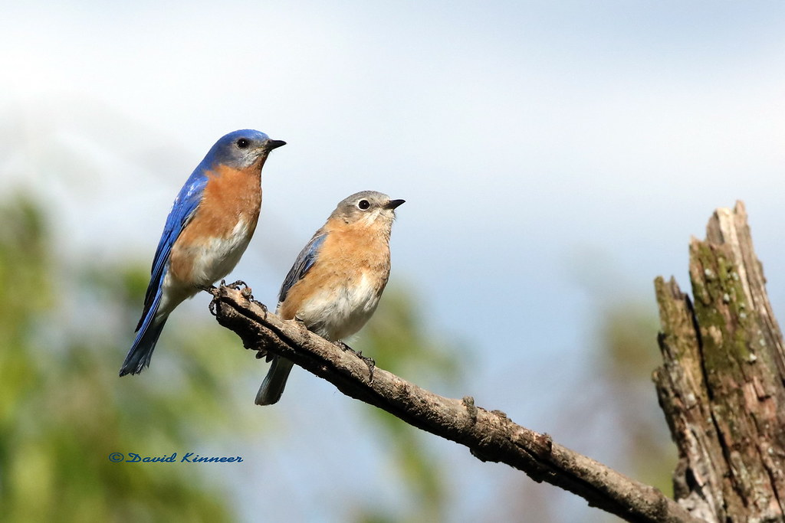
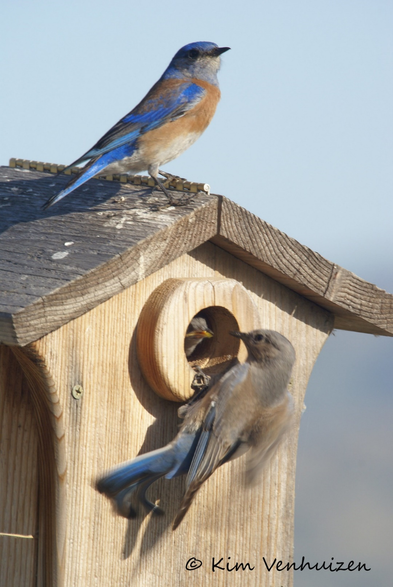
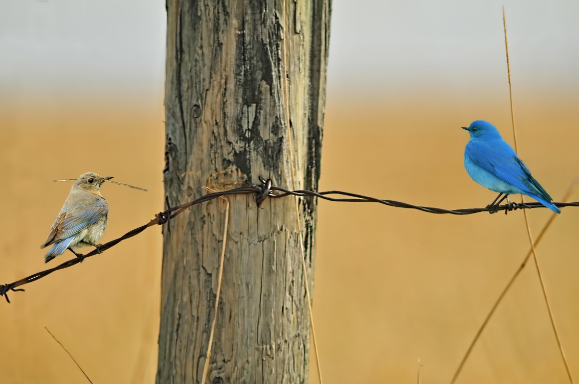
EASTERN
BLUEBIRD
MOUNTAIN
BLUEBIRD
WESTERN BLUEBIRD
Notes:
Three Species of Bluebirds. The youngsters look alike until the first molt.
Eastern Bluebird ranges from East coast to Rockies – from Canada to Central America
Western Bluebird ranges from west coast to Rockies – from Canada to Mexico.
Mountain Bluebird ranges through the Rockies – occasionally spotted in Texas

Slide 6
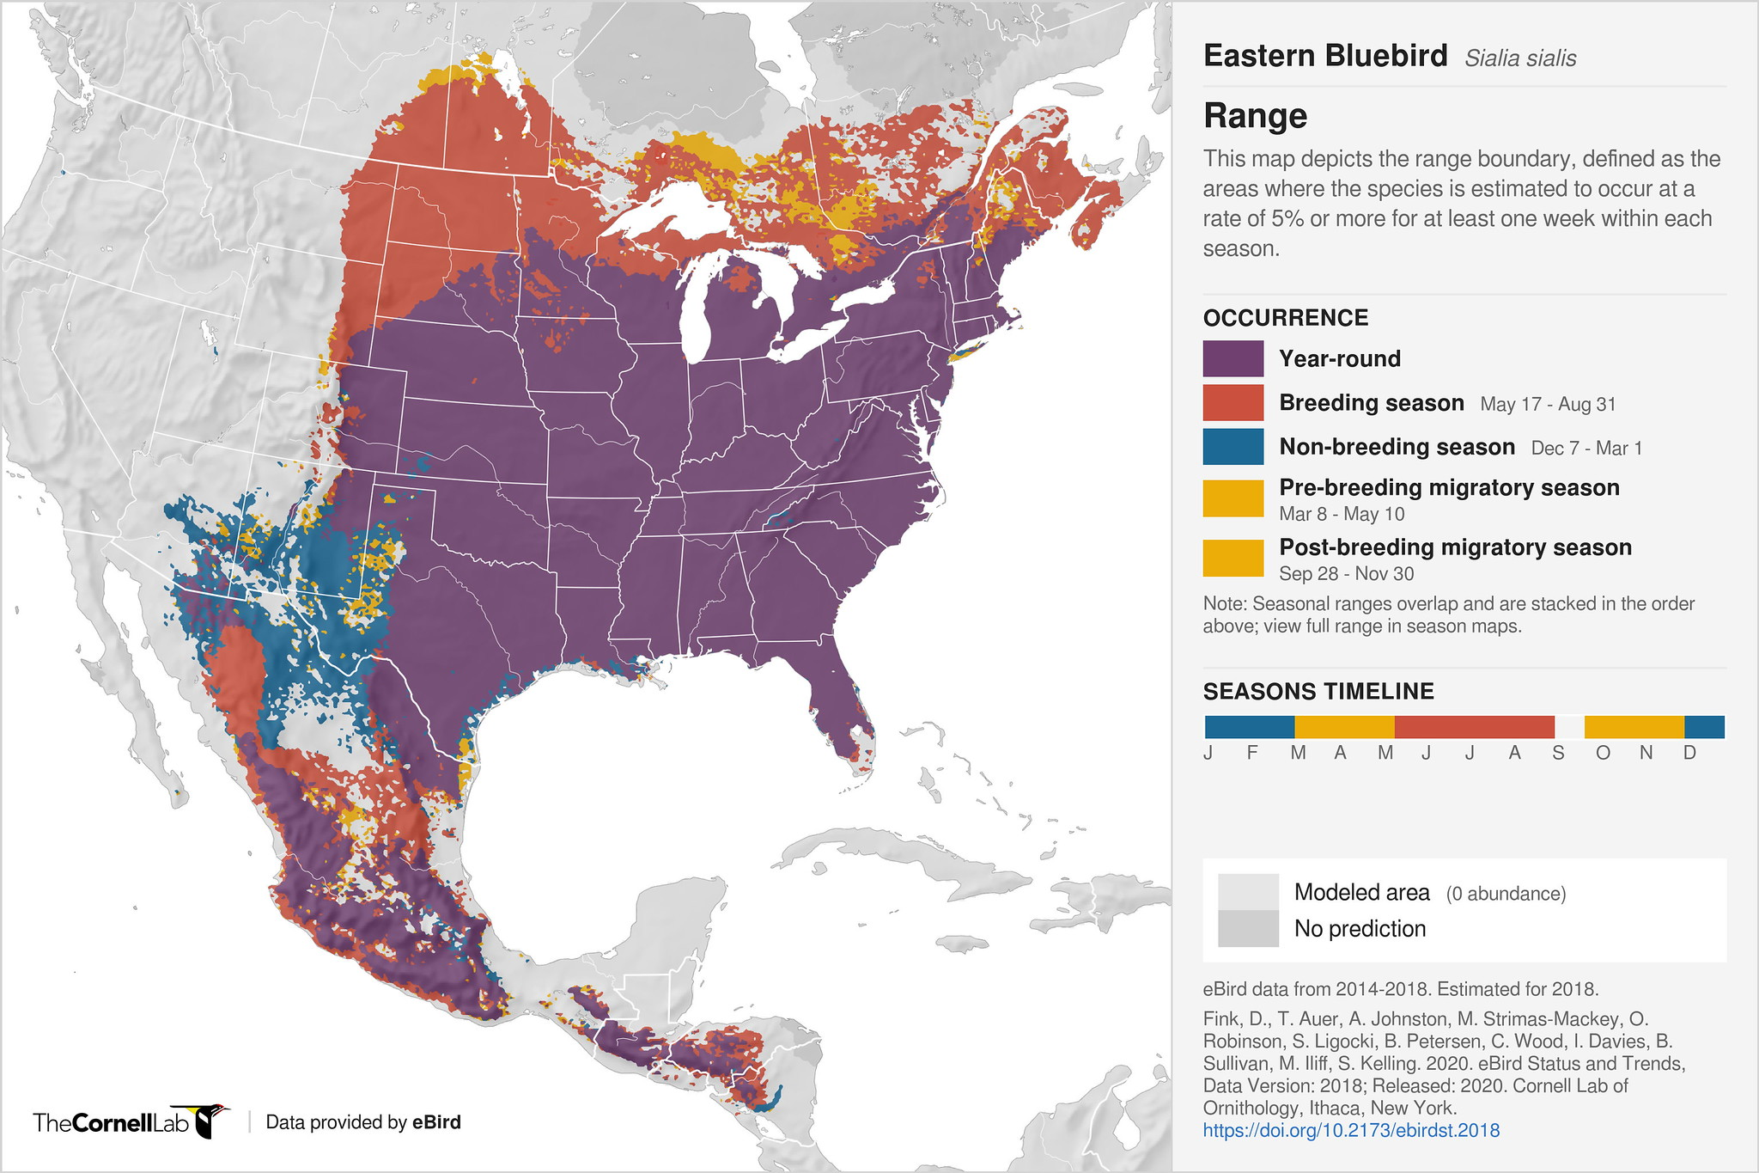
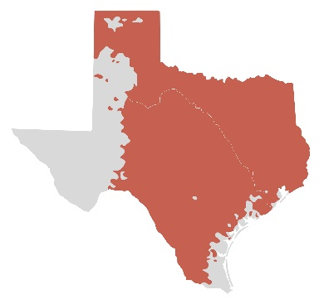
Eastern Bluebird
Notes:
Eastern Bluebird is only bluebird species breeding in Eastern 2/3 Texas.
For most of eastern 2/3 Texas, Eastern Bluebird is present year-round. Notice some spots along the coast do not have breeding bluebirds.
In Winter, when some bluebirds migrate south, Eastern Bluebirds are present across the state.

Slide 7
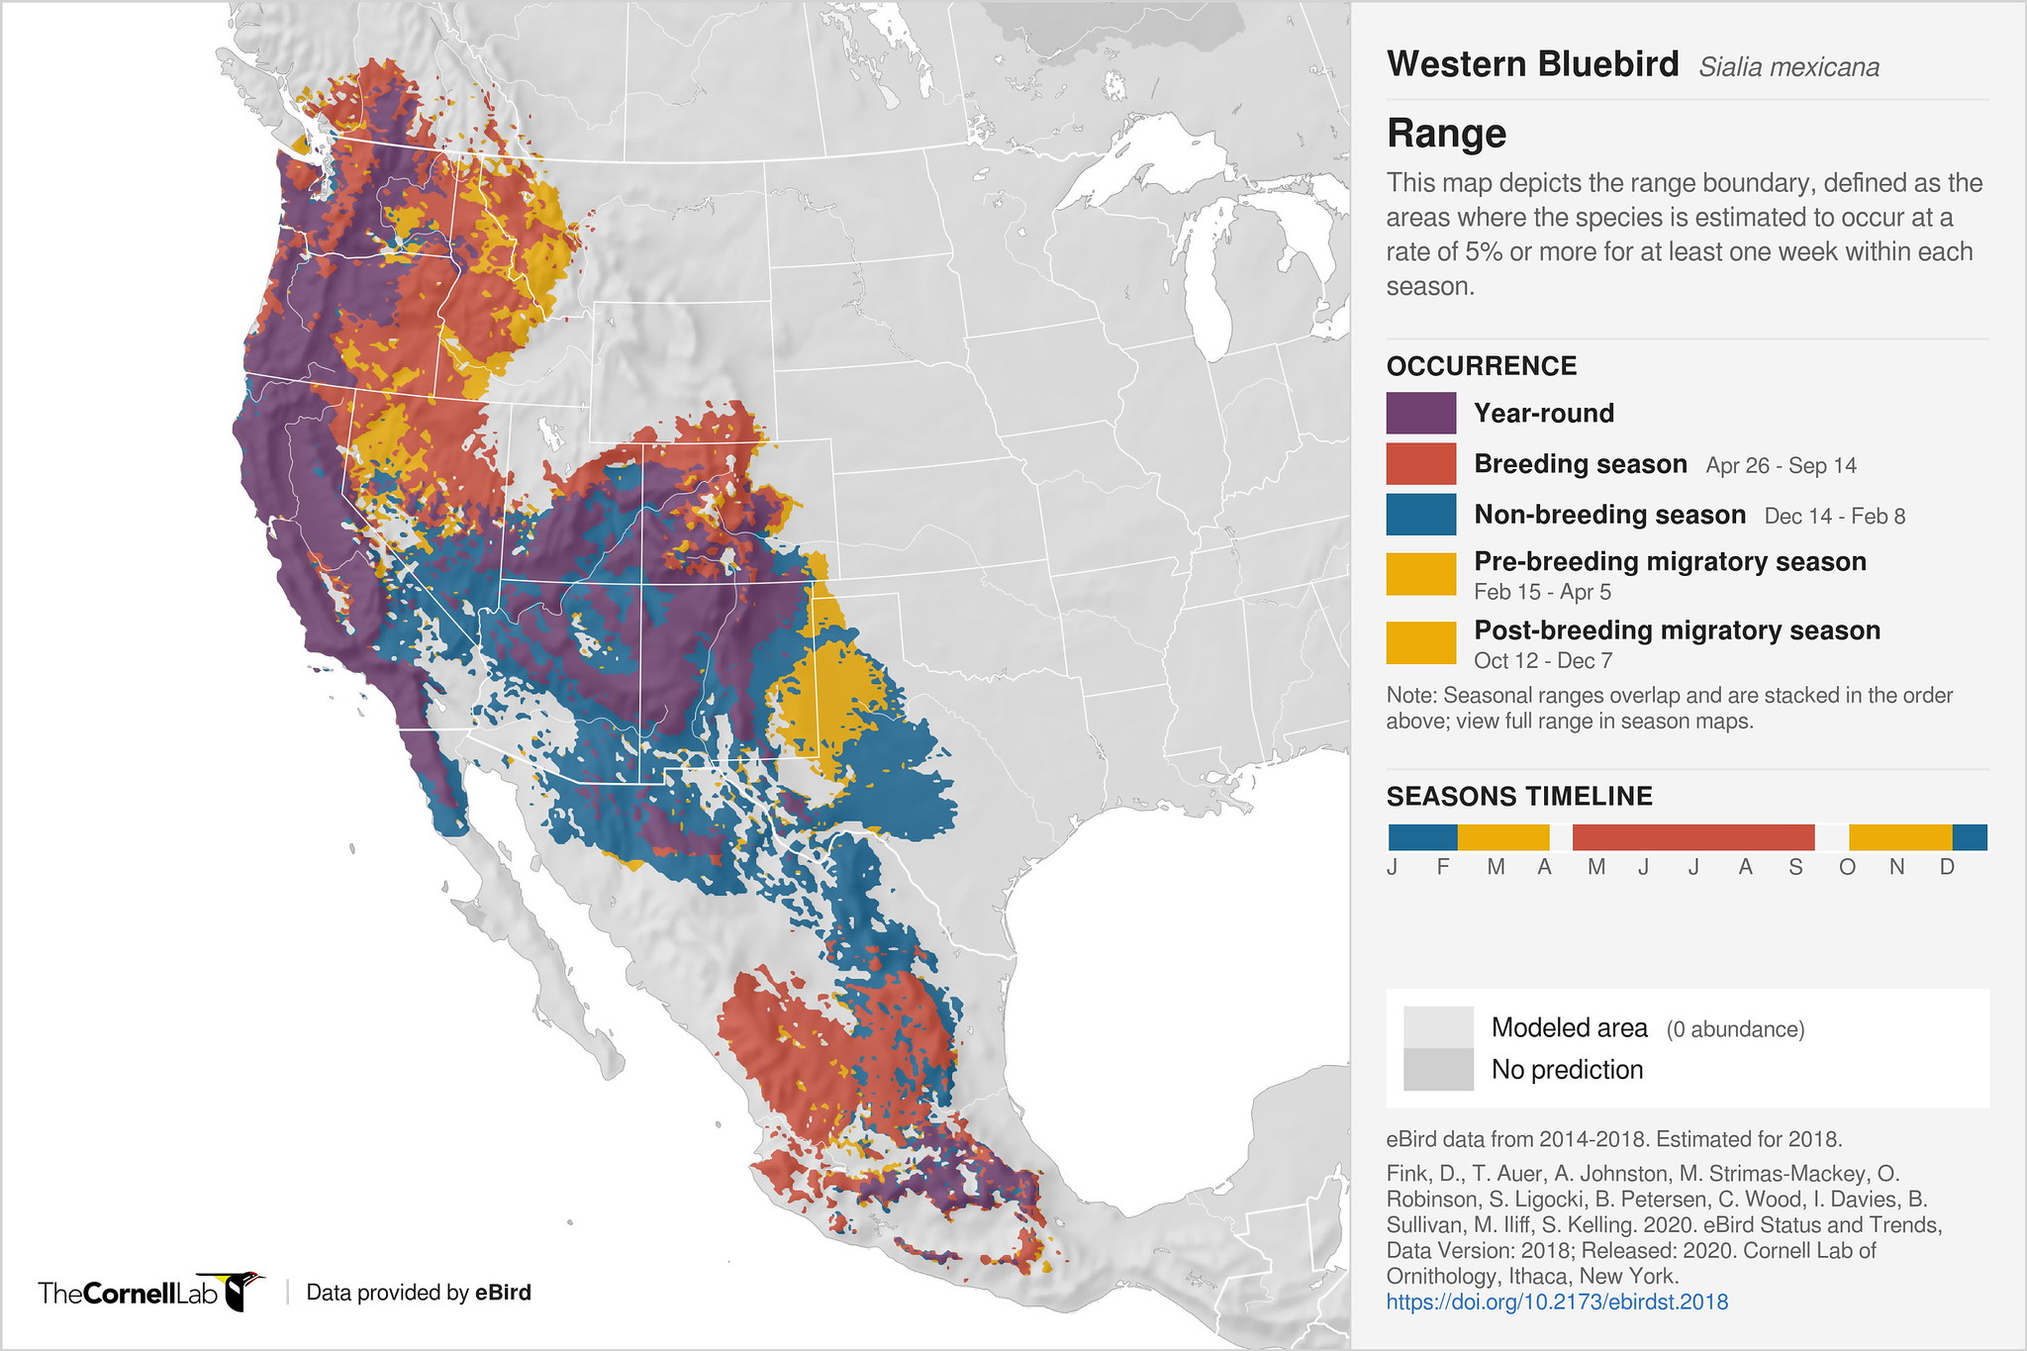
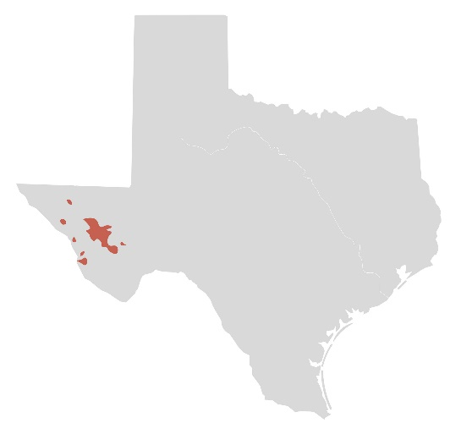
Western Bluebird
Notes:
Western Bluebird nests in isolated spots in Western Texas, including Davis Mountains.
Wintering Western Bluebirds are shown in blue.
Migrating Western Bluebirds are shown in gold.

Slide 8
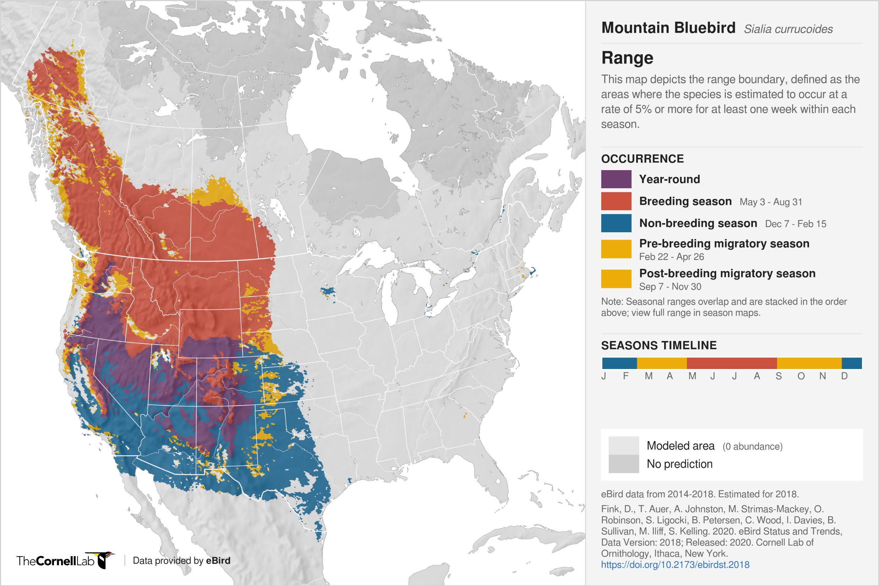
Notes:
Mountain Bluebirds do not nest in Texas.
There has been only one confirmed report of a Mountain Bluebird nest in Texas.

Slide 9
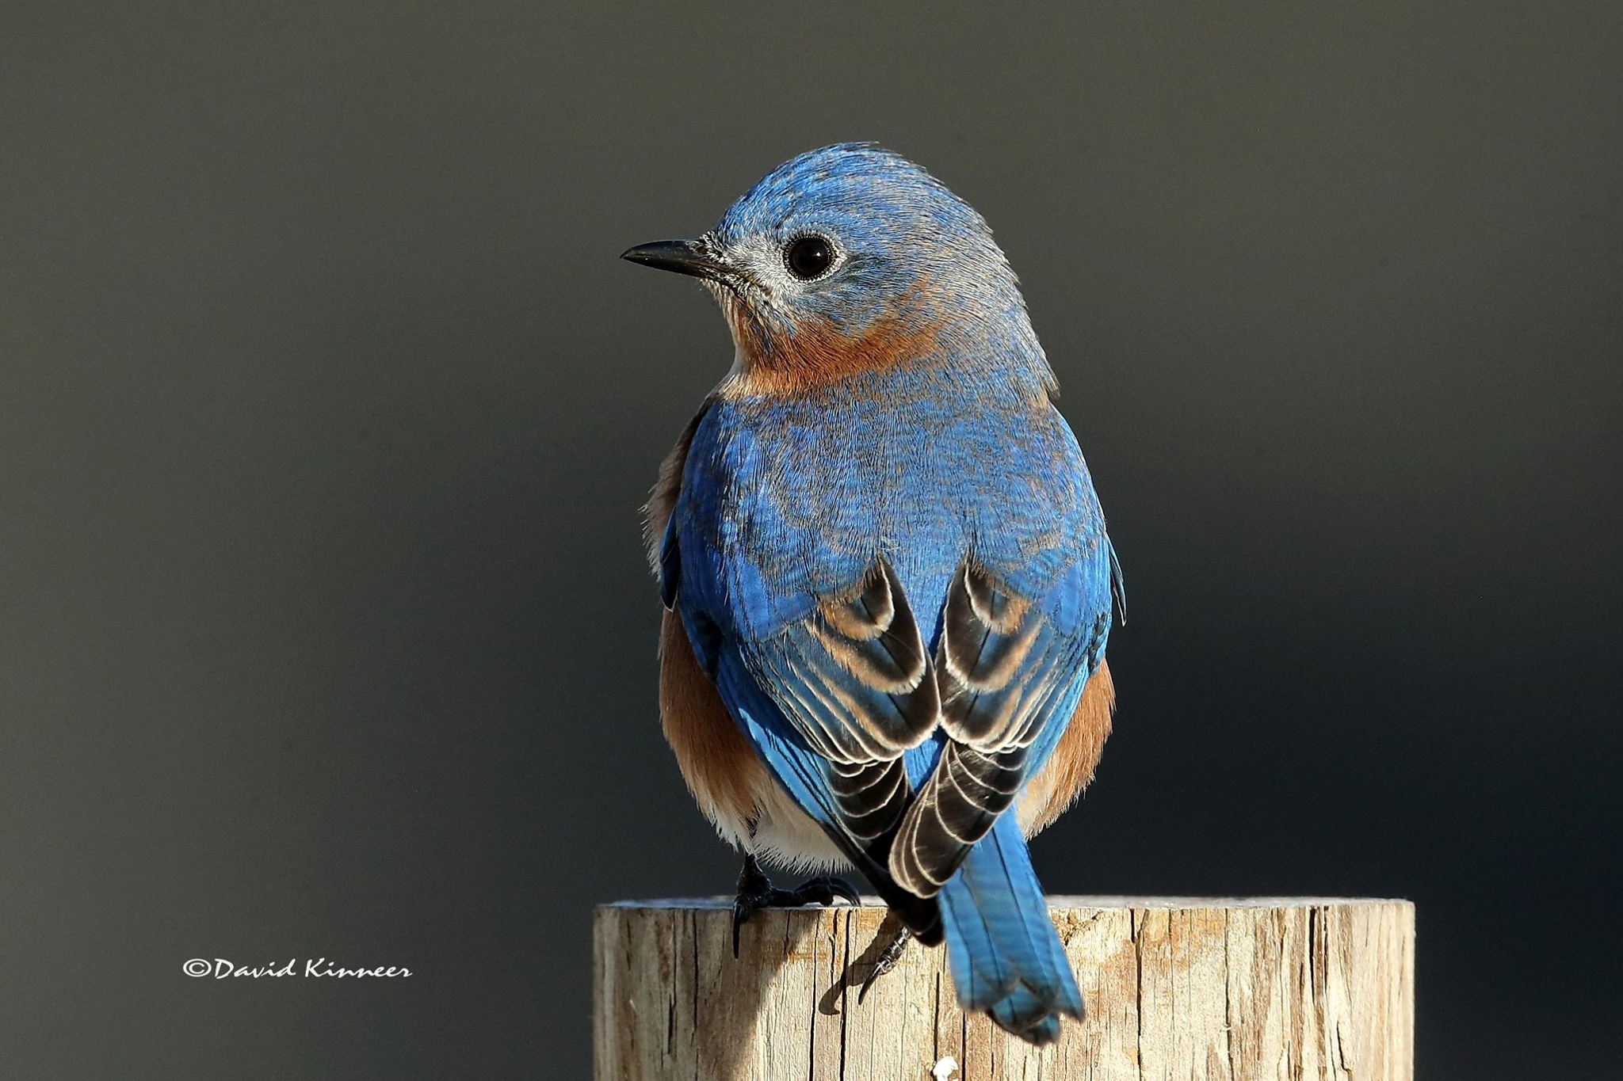
Notes:
Object of our affection.
Thrush family. Eastern Bluebird, Sialia sialis
Secondary cavity nester. Unable to excavate own cavity. Relies upon abandoned woodpecker holes, natural cavities, or nestboxes.
Not endangered or threatened. Well established as a species
According to Partners in Flight, 2020, 23 million Eastern Bluebirds
Ranked 58th of 63 cavity nesters in Conservation Priority
Bluebird of Happiness – over 100 songs written with “bluebird”

Slide 10
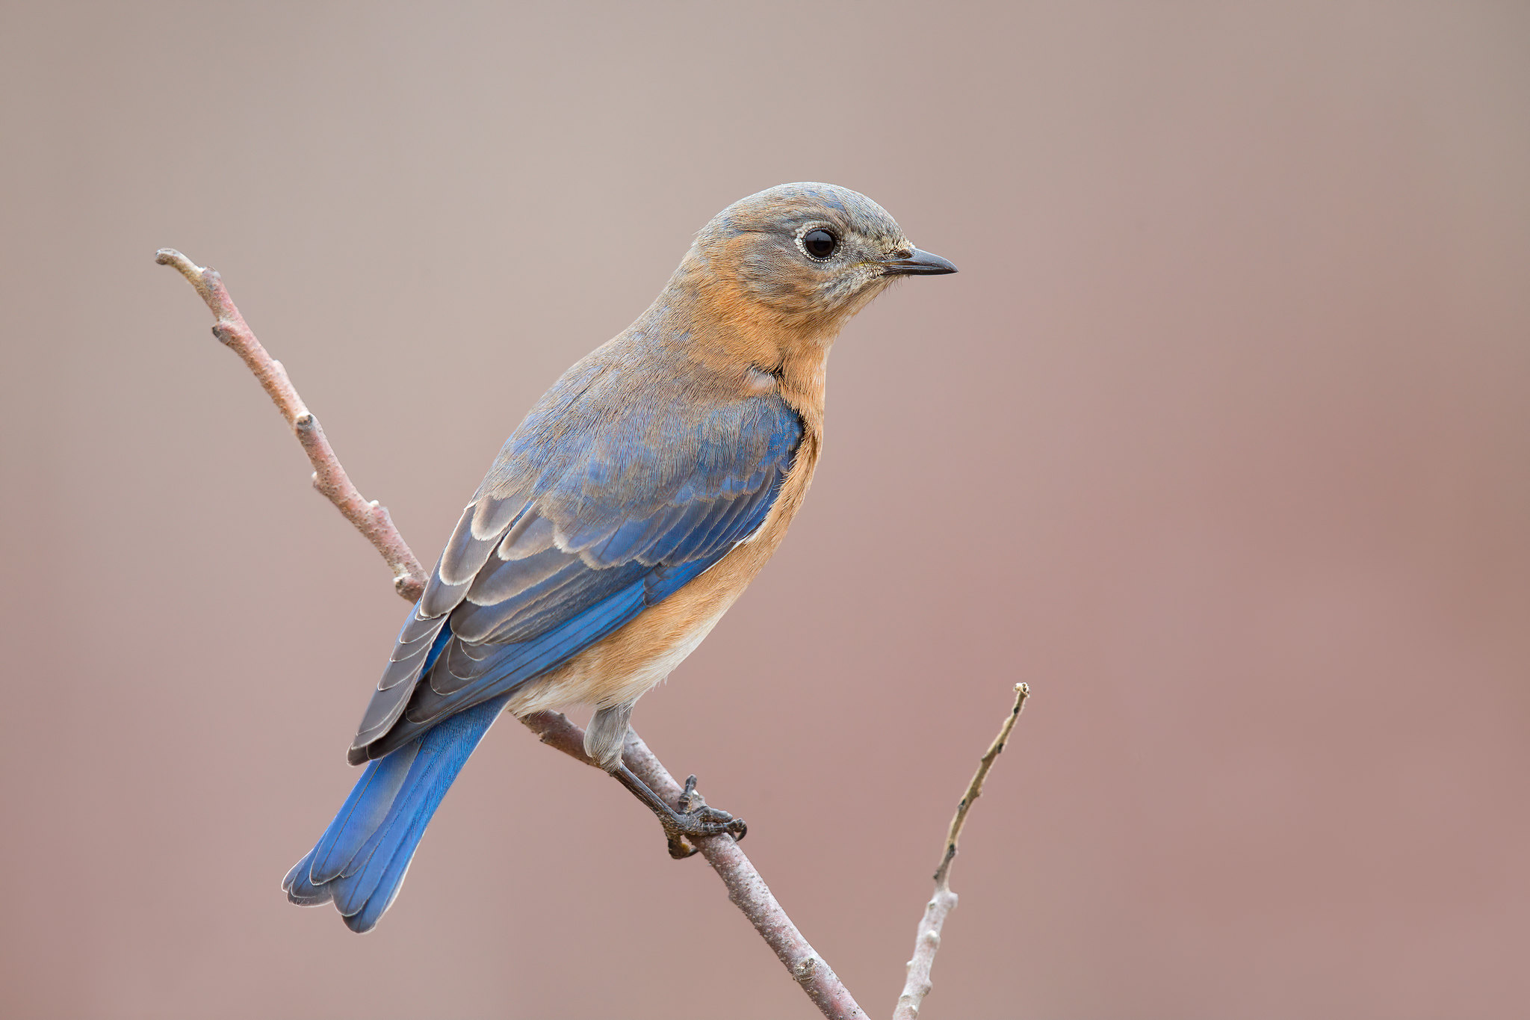
Notes:
…. Let’s not forget the gorgeous female

Slide 11
The bright blue flash of a male bluebird in the sunlight is often the kind of magic that sparks people’s interest so much that it moves them to put up a nestbox and monitor the progress all spring and summer.
Jonathan Ridgeway
Notes:
Presenter: Please do not read. Give a few seconds to the audience.

Slide 12
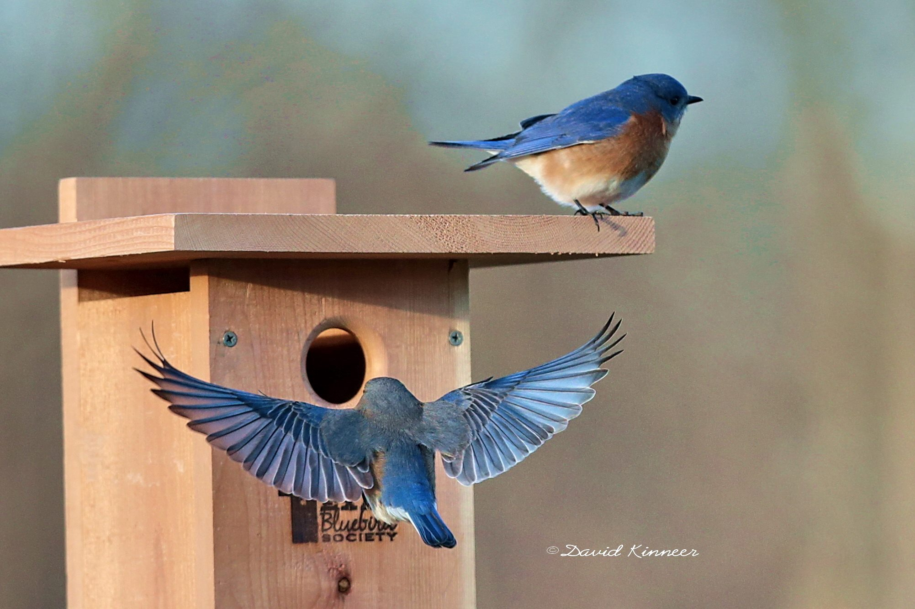
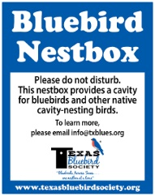
Notes:
This is the take-your-breath-away sight to expect as bluebirds lay claim to a nestbox.
But, first, you must determine an appropriate spot for your nestbox, obtain a nestbox, and install the nestbox.
The male is the more colorful of the two.

Slide 13
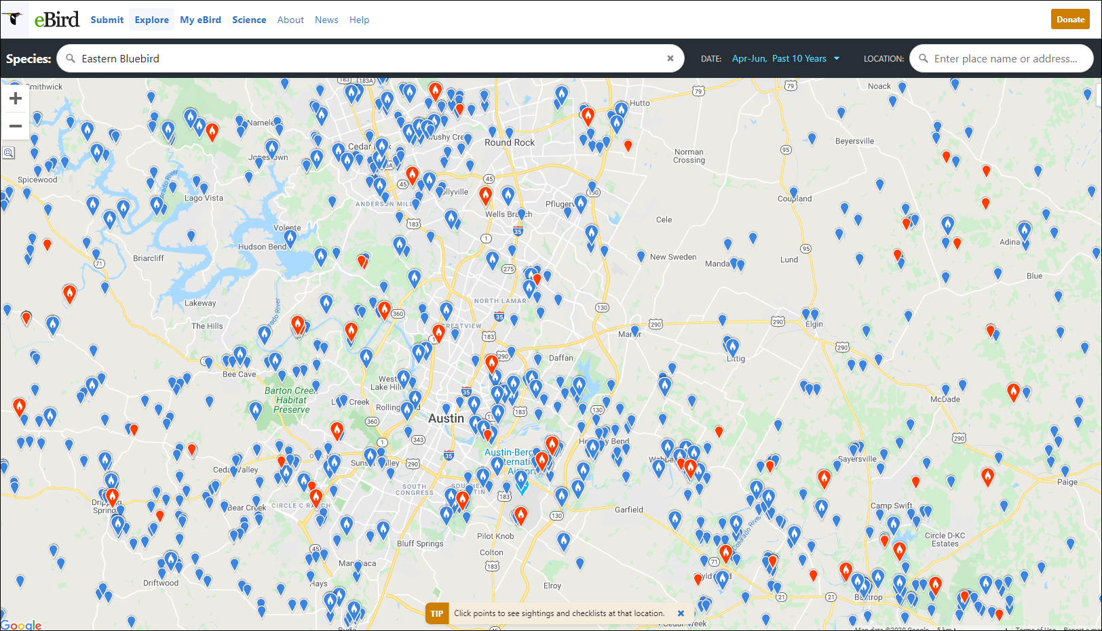
eBird.org
Apr - June, 2010 - 2020 Observations
Local Region (this shows Austin)
Notes:
IS it POSSIBLE to have nesting bluebirds where you live?
These are bluebird sightings reported to eBird.org during nesting season (April - June, 2010 – 2020.)
Note to presenter: During preparation, please add image of current ebird sightings for the “region” where you are presenting.
Best option: Go to eBird.org, Explore (more ways to explore, Species Map. Species: Eastern Bluebird, Date: most recent “2 – 10 years” (or so).
If using desktop, use “snipping tool” to obtain an image. (If using MAC, determine how to get a jpg of what you see on screen.)
If you need help, try contacting tbs@Txblues.org at least two weeks before your presentation.

Slide 14
After you save this file on your computer / thumb drive with a new name, INSERT THE JPEG YOU CREATE using eBird of your local area. Then, delete previous slide. Delete this text.

Slide 15
Notes:
Words from the Texas Bluebird Society “Bluebird Habitat” metal sign provide the basics as you look for a spot for your nestbox.
Look at the wording on the habitat sign:
Somewhat open space
Short grass
High perches
Insects
Also, there’s value in afternoon shade, if possible

Slide 16
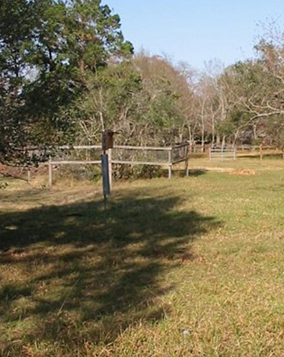
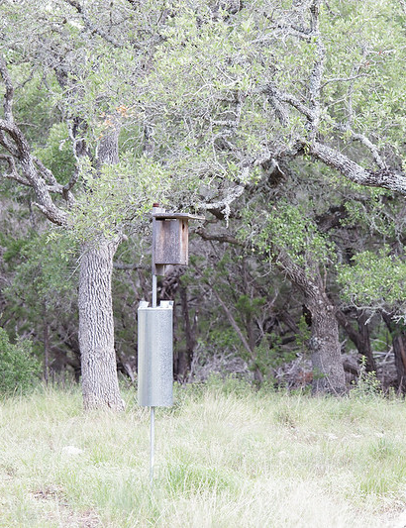
Notes:
Open space within wooded area provides high perches for spotting insects and protecting the nest. (BOW) Individuals identify appropriate prey from distances of 15–20 m, sometimes as far away as 40 m, and “drop forage”.
2. Open space in Texas Hill Country provides high perches for spotting insects and protecting the nest.

Slide 17
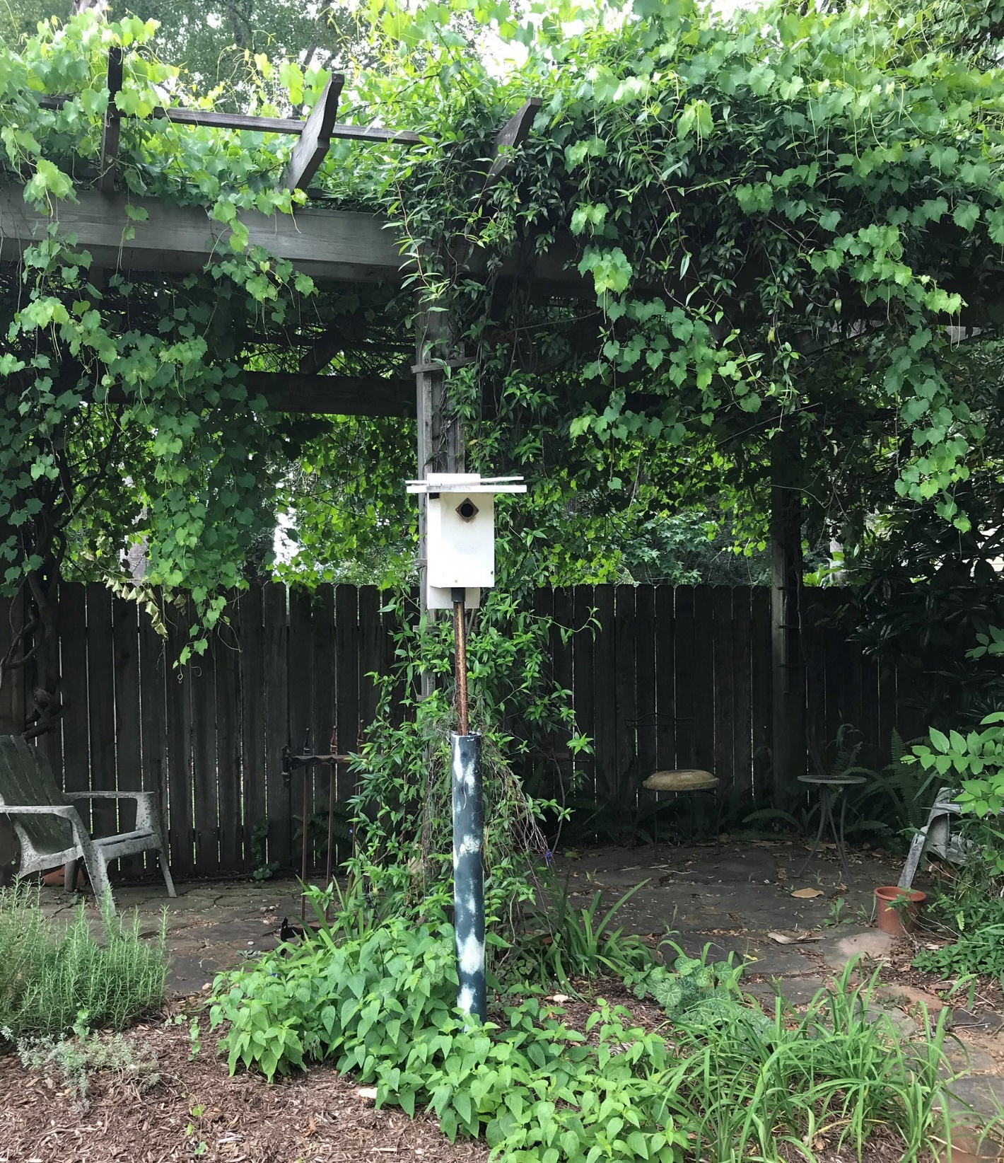
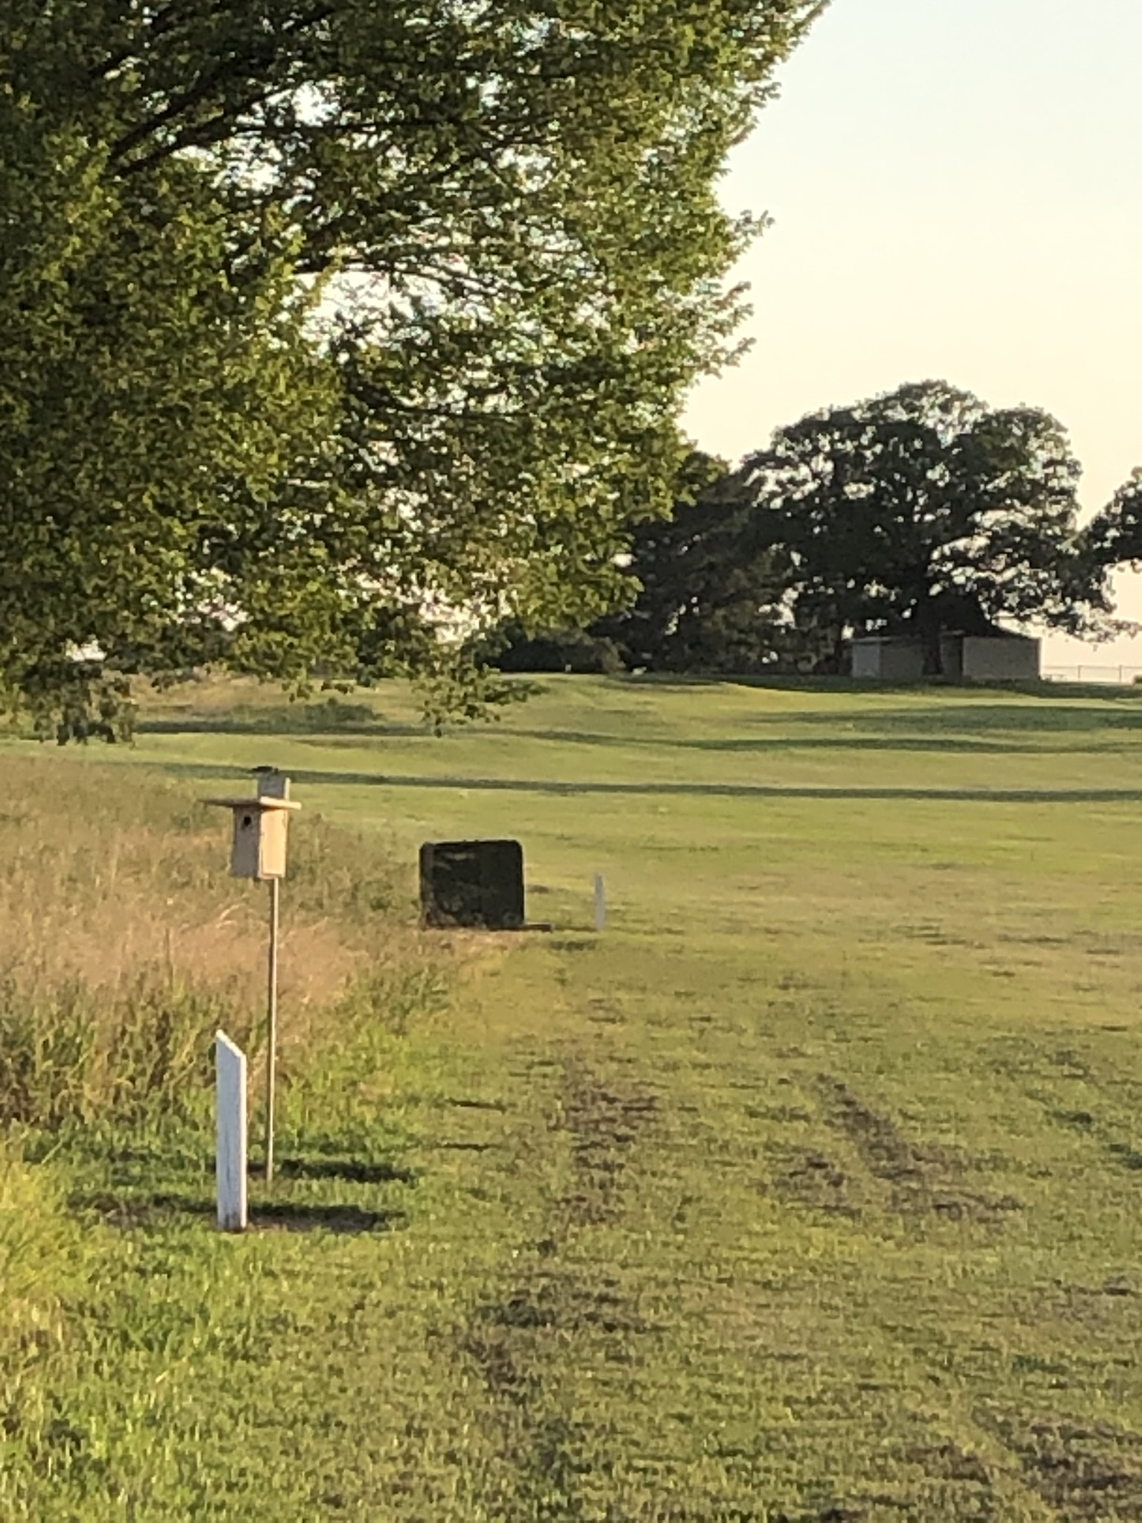
Notes:
A suburban backyard garden in Montgomery County provides the basic bluebird habitat.
And, so does this golf course near Huntsville TX.

Slide 18
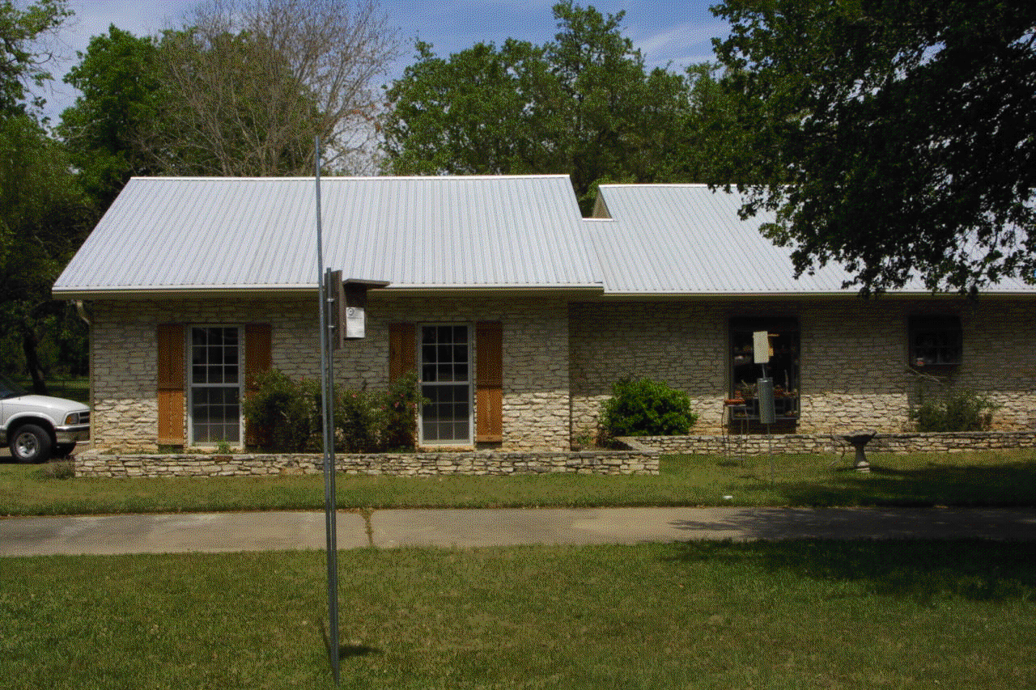
Pauline Tom
Notes:
Tom lawn in Mountain City, south of Austin, with active bluebird nestbox in foreground. Carolina Chickadee and Black-crested Titmouse nested by kitchen window while bluebirds nested.
Somewhat open space
Short grass
High perches
Insects
Afternoon shade, if possible
(audience might see short grass, nearby attack/hunting perch (the 10-foot EMT conduit mounted beside the nestbox and tree branches); tree to which the babies can fledge, short grass, somewhat open area, bird bath

Slide 19
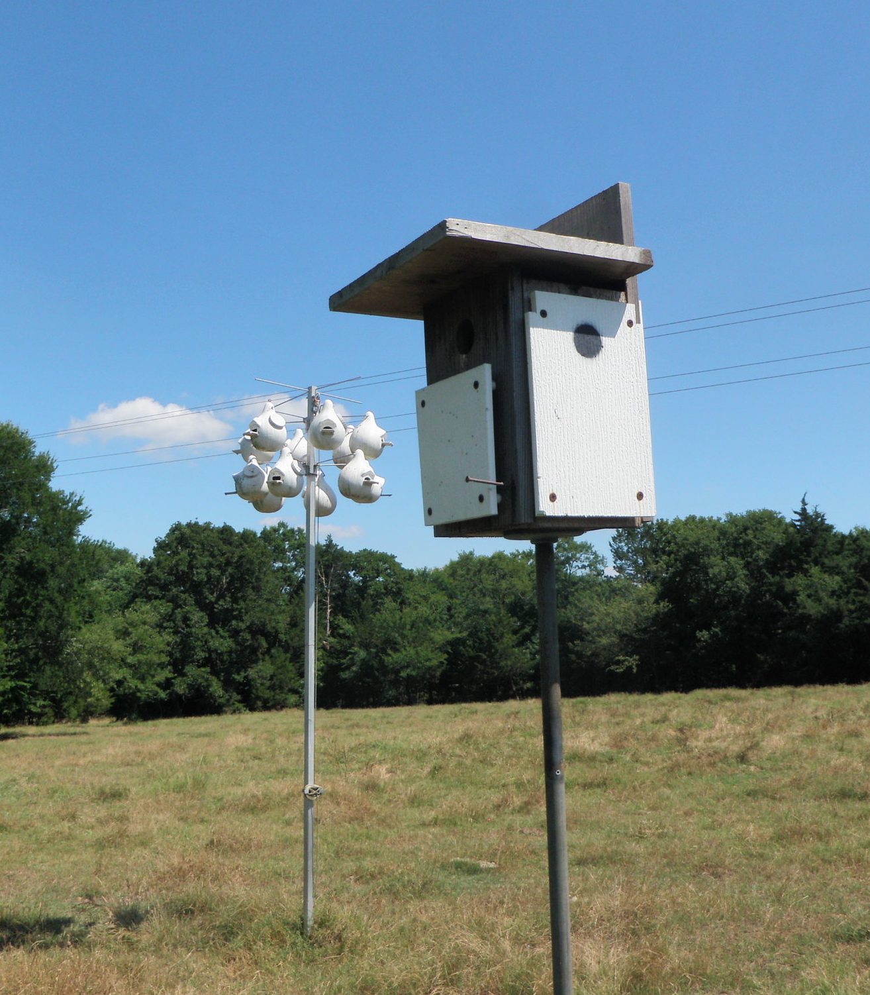
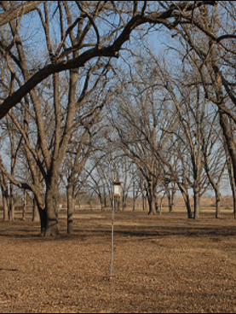
Notes:
Bluebirds and Purple Martins require similar habitat.
They eat different insects (martins from the air; bluebirds from the ground) so they can share habitat.
Utility wires are excellent “perches” for bluebirds unless there is a problem with hawk predation.
2. This photo, taken in winter, shows location of nestbox with SOMEWHAT open space under high canopy of pecan trees. Bluebirds nest here into August, in shade.
Somewhat open space
Short grass
High perches
Insects
Afternoon shade, if possible

Slide 20
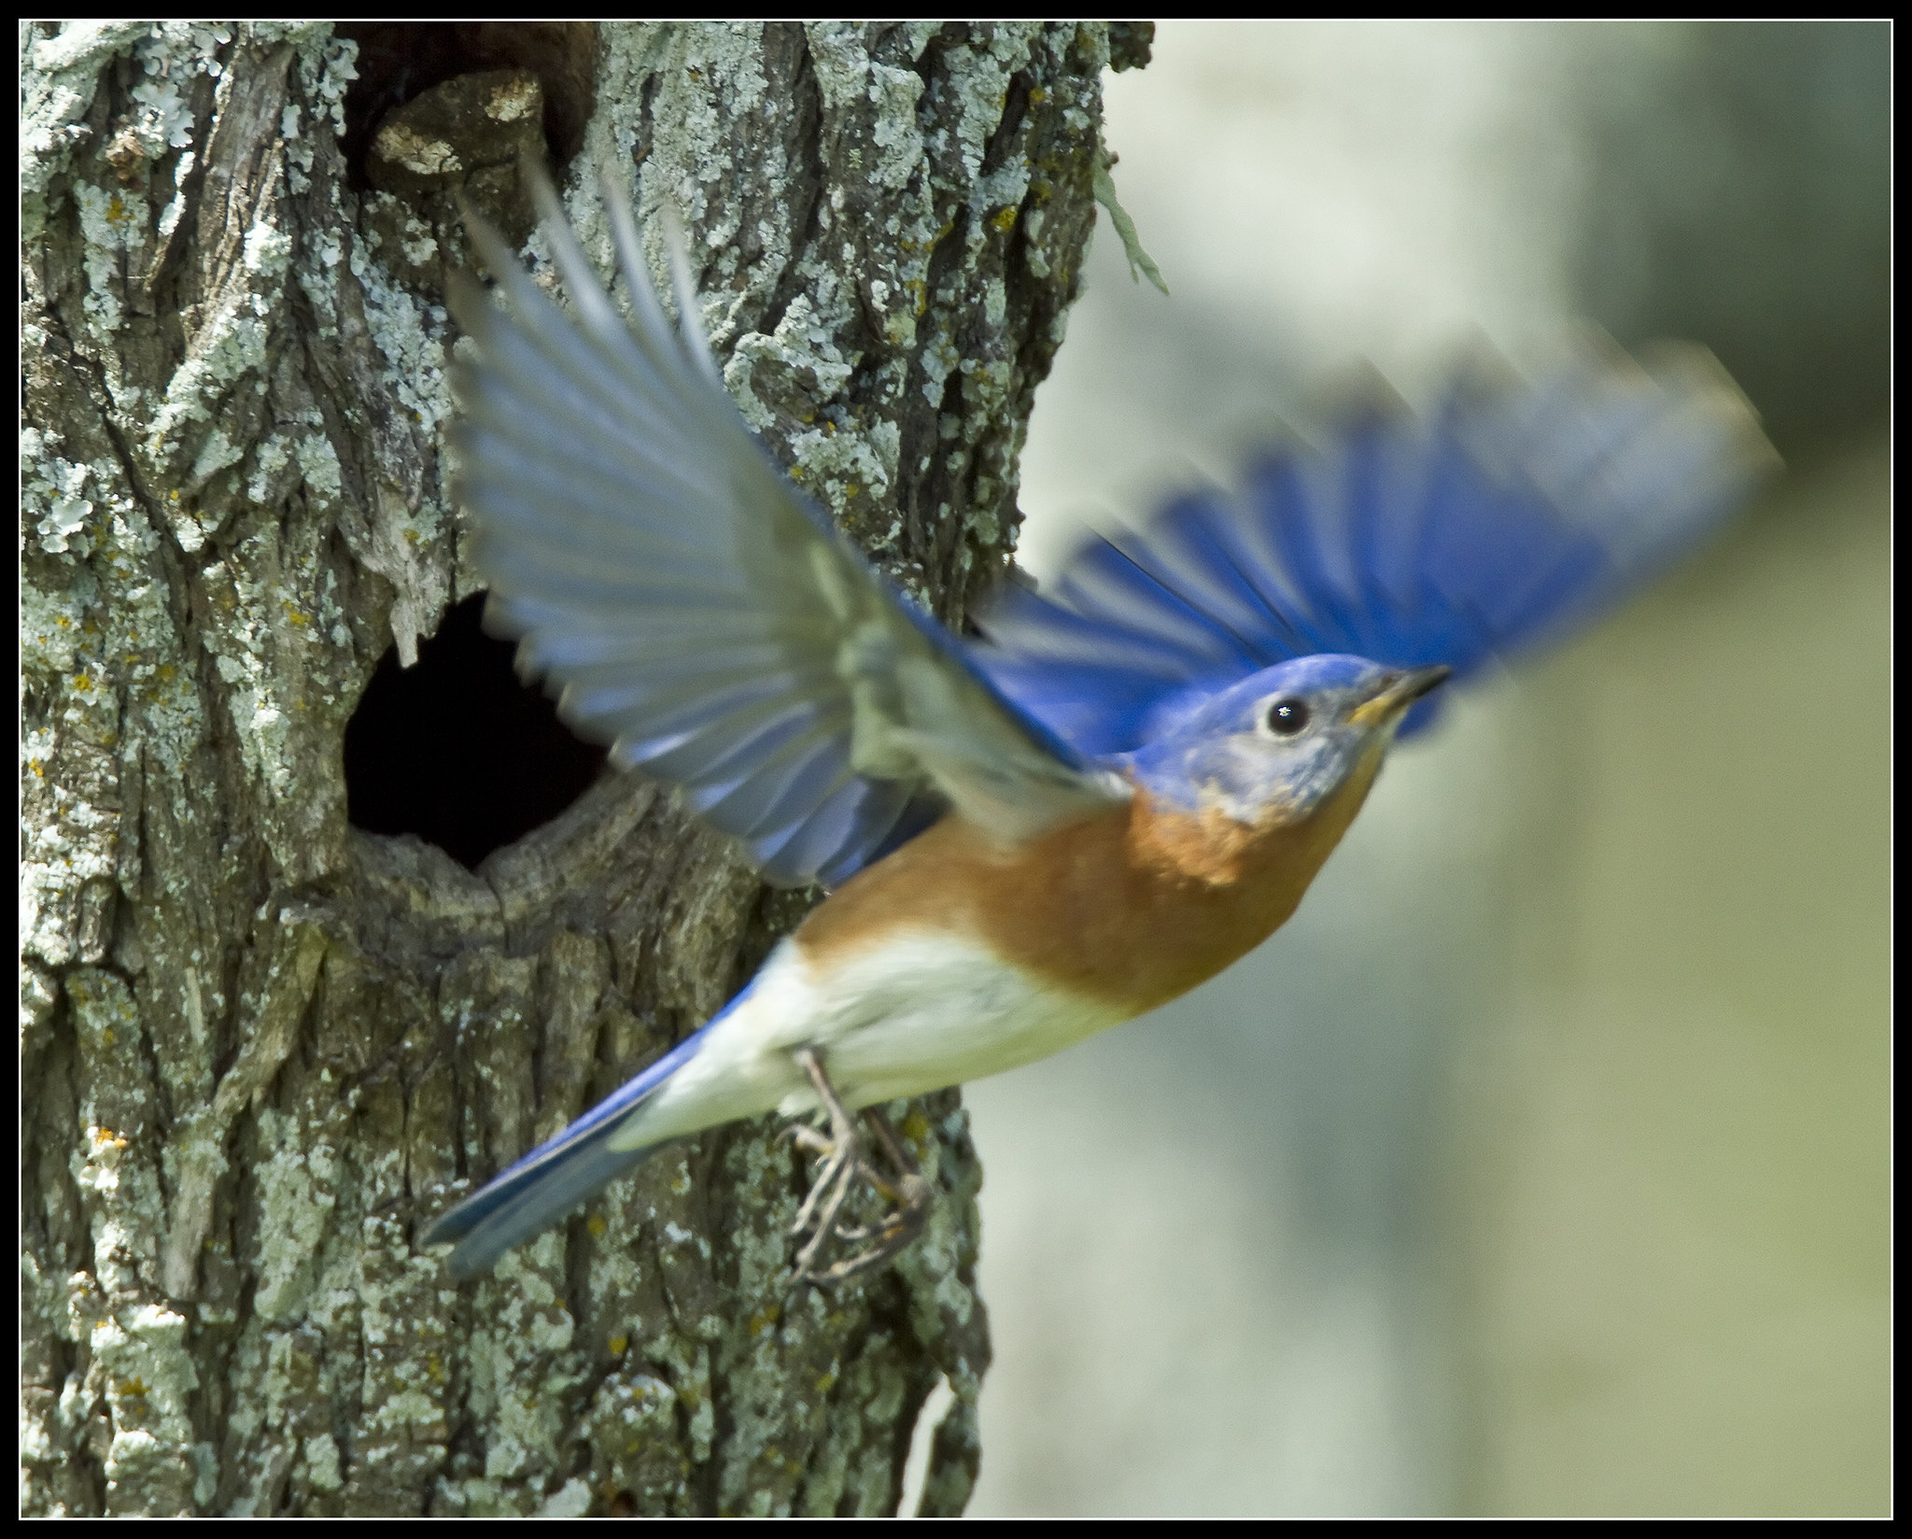
Conserve Dead Trees (Snags)
Notes:
Bluebirds require a cavity in order to nest.
Conservation of dead trees (snags), when feasible, is vital adjunct to provision of nestboxes.
Eastern Bluebird is just one species in cavity dwelling wildlife communities that depend upon dead and dying trees.

Slide 21
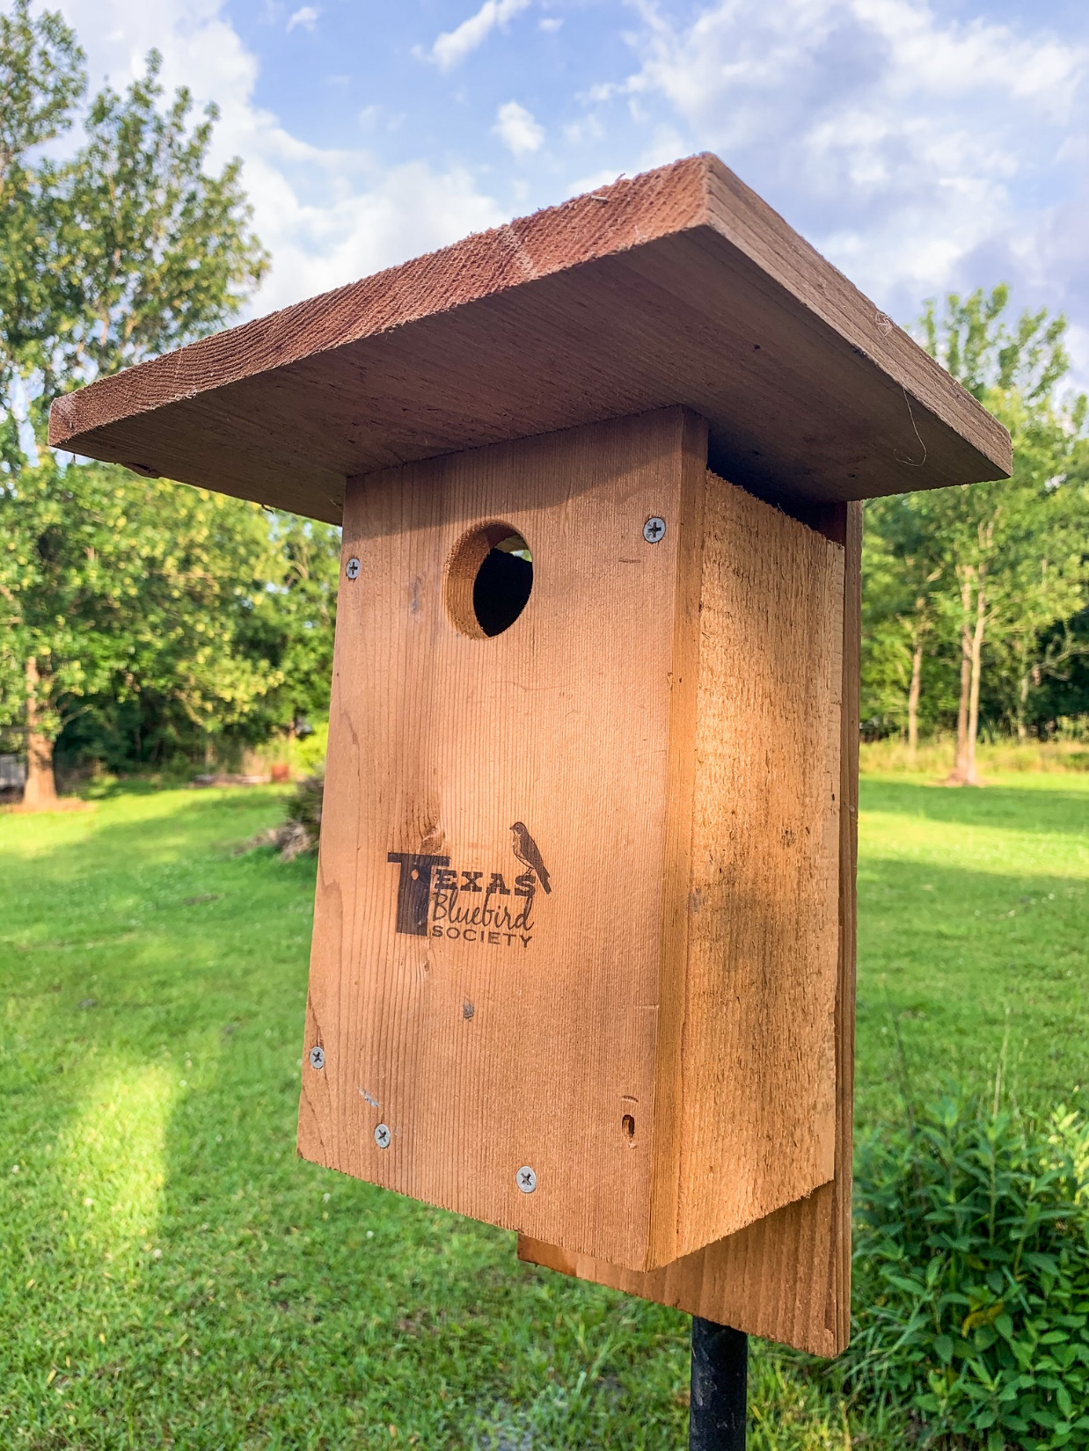
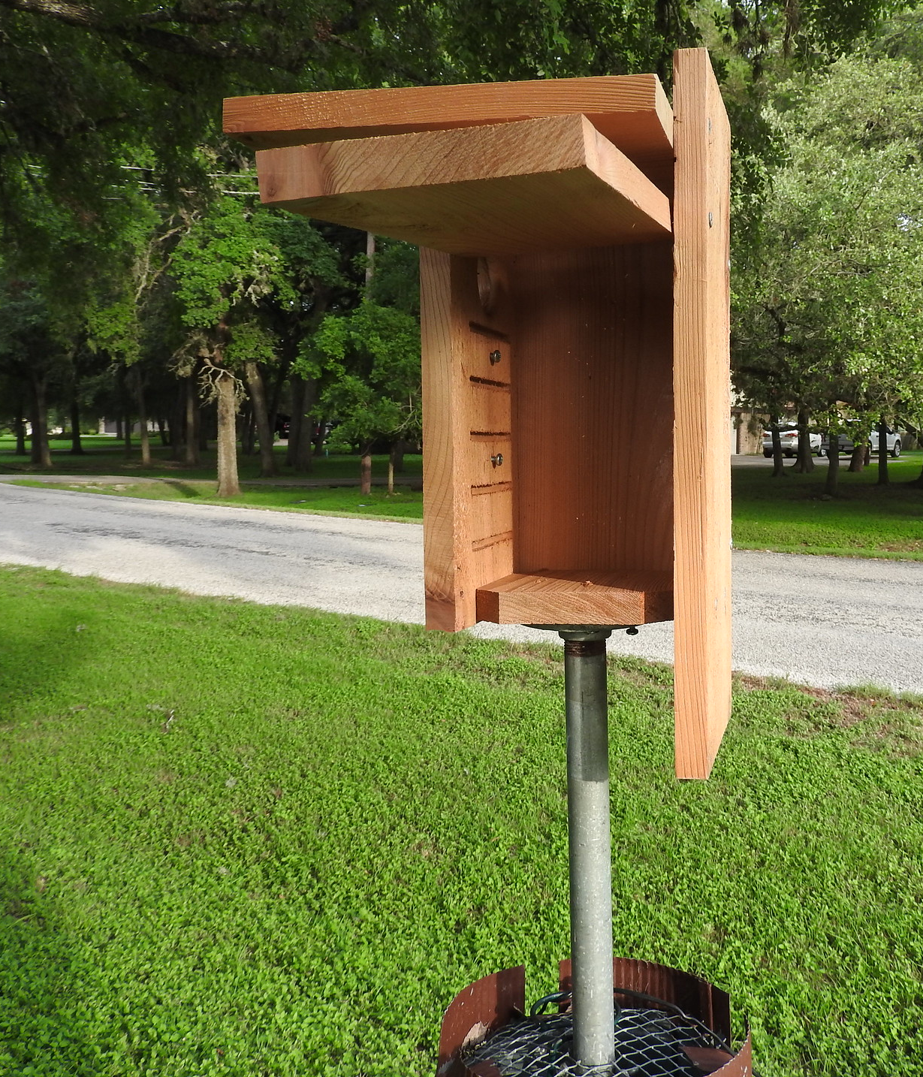
Notes:
A bluebird nestbox is an artificial “woodpecker cavity.”
The side-opening “Texas Nestbox” distributed by Texas Bluebird Society is designed for Texas’ conditions (for instance, wide overhanging shade roof). It comes equipped with screws under the hole for the VanErt House Sparrow Trap, and, it has “kerfs” – a ladder that’s necessary for weak-footed Tree Swallows.
The plans for this nestbox can be found on the Texas Bluebird Society website.

Slide 22
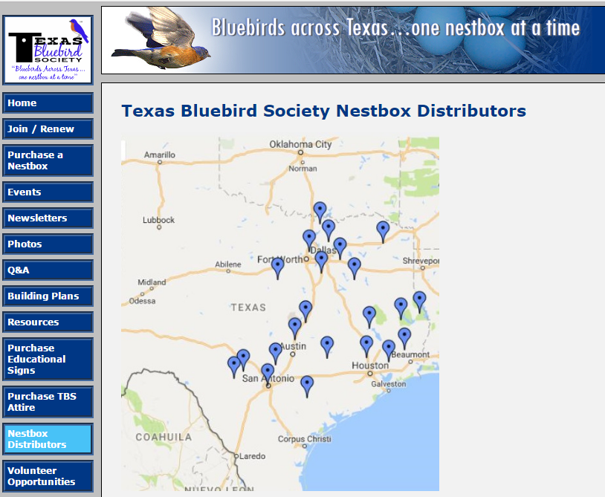
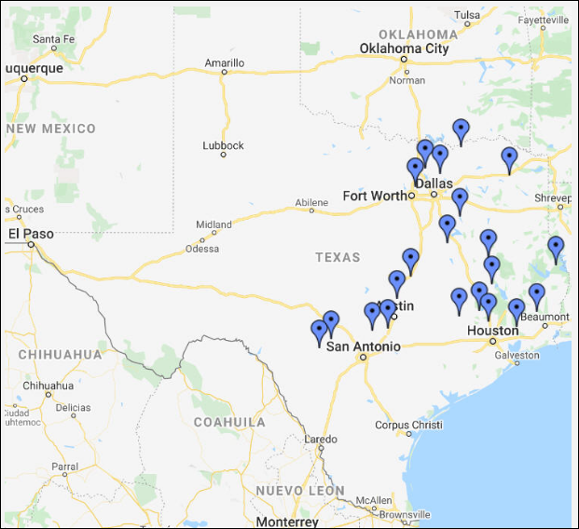
Texas Nestbox Distributors
Notes:
To obtain a Texas Bluebird Society nestbox, contact a TBS Nestbox Distributor
or
order (in quantities of 4) online. Contact info can be found on TBS website.

Slide 23
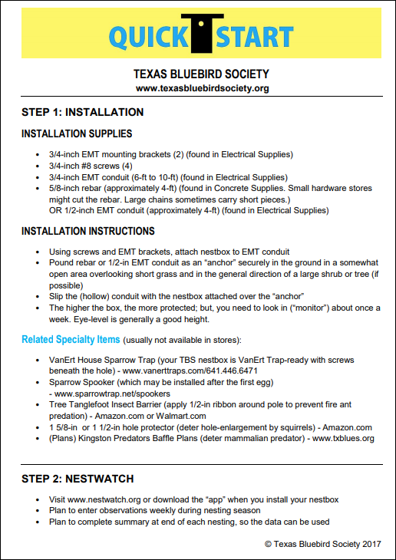
QUICKSTART
https://txblues.org
Publications
Notes:
Texas Bluebird Society’s “QuickStart” gives recommended method for mounting nestboxes (with materials list).
It’s available online and it is given as a yellow card in new member materials.

Slide 24
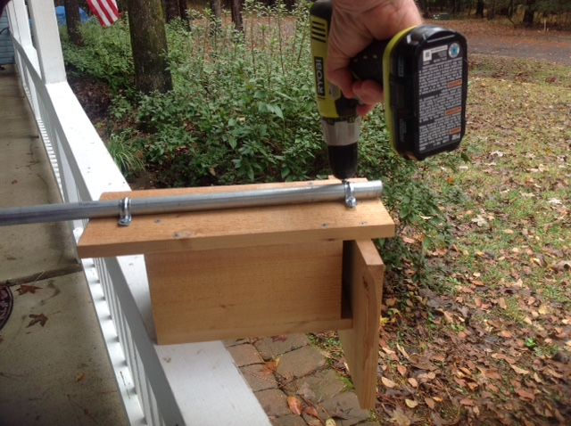
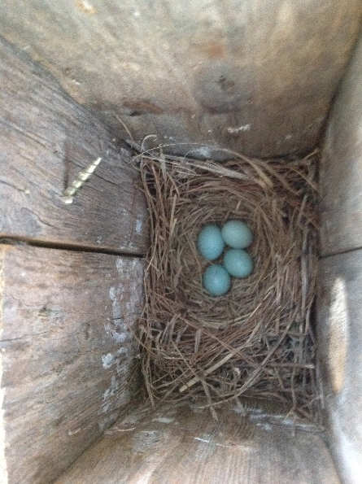
3/4 inch EMT conduit “pole”
3/4 inch EMT straps
3/4 inch #8 screws
Notes:
Mounting nestbox to ¾” EMT with clamps and screws
(Note: make sure screws don’t go into the nestbox cavity, where they might cut the birds.)

Slide 25
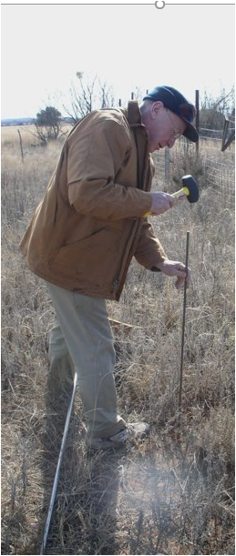
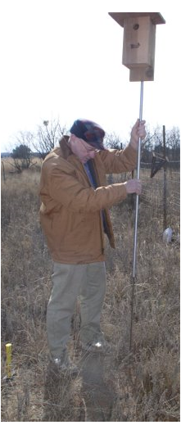
SIMPLE INSTALLATION
ADD AN ANCHOR TO GIVE STABILITY TO ¾-inch EMT CONDUIT “POLE”:
4-foot stick of 5/8 inch rebar (Edwards Plateau)
OR
4-foot stick 1/2-inch EMT conduit (soft soil)
SLIP MOUNTED NESTBOX OVER ANCHOR.
Facing eastward is usually best.
Notes:
Anchor can be 5/8-inch rebar or ½-inch emt conduit, depending on soil conditions
Drive 4-foot rebar (or EMT conduit) “anchor” into ground for stability. Then, slide ¾ inch EMT conduit “pole”, with nestbox affixed, over the anchor and push conduit into soil (so it doesn’t turn with wind) – mounting is complete !

Slide 26
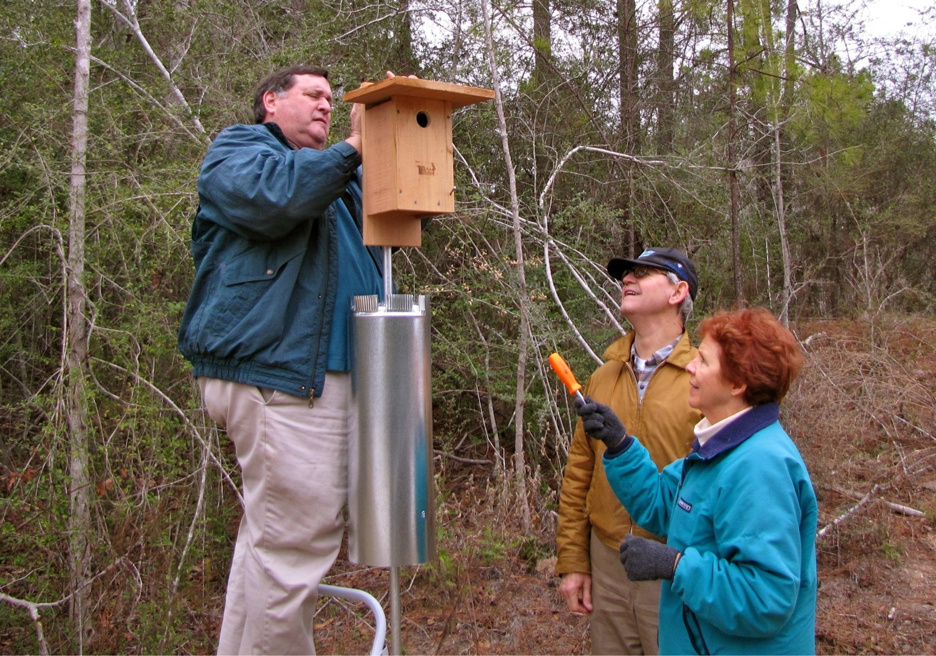
Notes:
“Best practice” installation will be complete with addition of Kingston Stovepipe Predator Baffle. (Plans available online, on TBS’ website, and in “Bluebirds in Texas” publication by Texas Parks & Wildlife.)

Slide 27
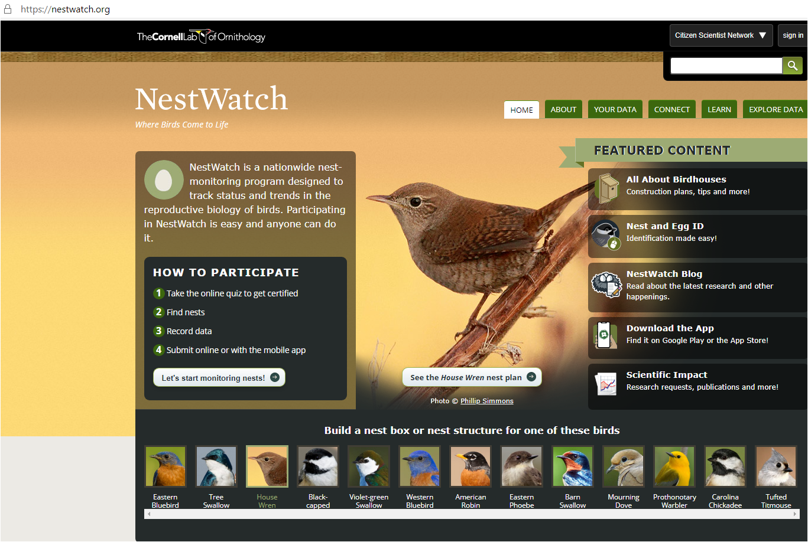
NestWatch.org
Notes:
Option 1 for mentioning NestWatch
Please check out and register in the free NestWatch program from Cornell University Lab of Ornithology – Any and all data reported to NestWatch helps scientists collect valuable data on successes and failures of nesting birds. The more data collected, the better. The NestWatch system needs records by the 100,000’s – one at a time.
You will also have your records for personal use.
Report in “live time” as you go using NestWatch app, or, from journal notes (even months later).
Start watching for nests to observe – any avian species!
Option 2 for mentioning NestWatch
If you have nesting birds (in a nestbox or not) you can contribute data to scientists by reporting nesting observations about twice a week to NestWatch (app or website). NestWatch will store your nesting records and make them part of the massive database. NestWatch monitoring program is designed to track status and trends in the reproductive biology of birds, including when nesting occurs, number of eggs laid, how many eggs hatch, and how many hatchlings survive.
OR, create a combination explanation of NestWatch.

Slide 28
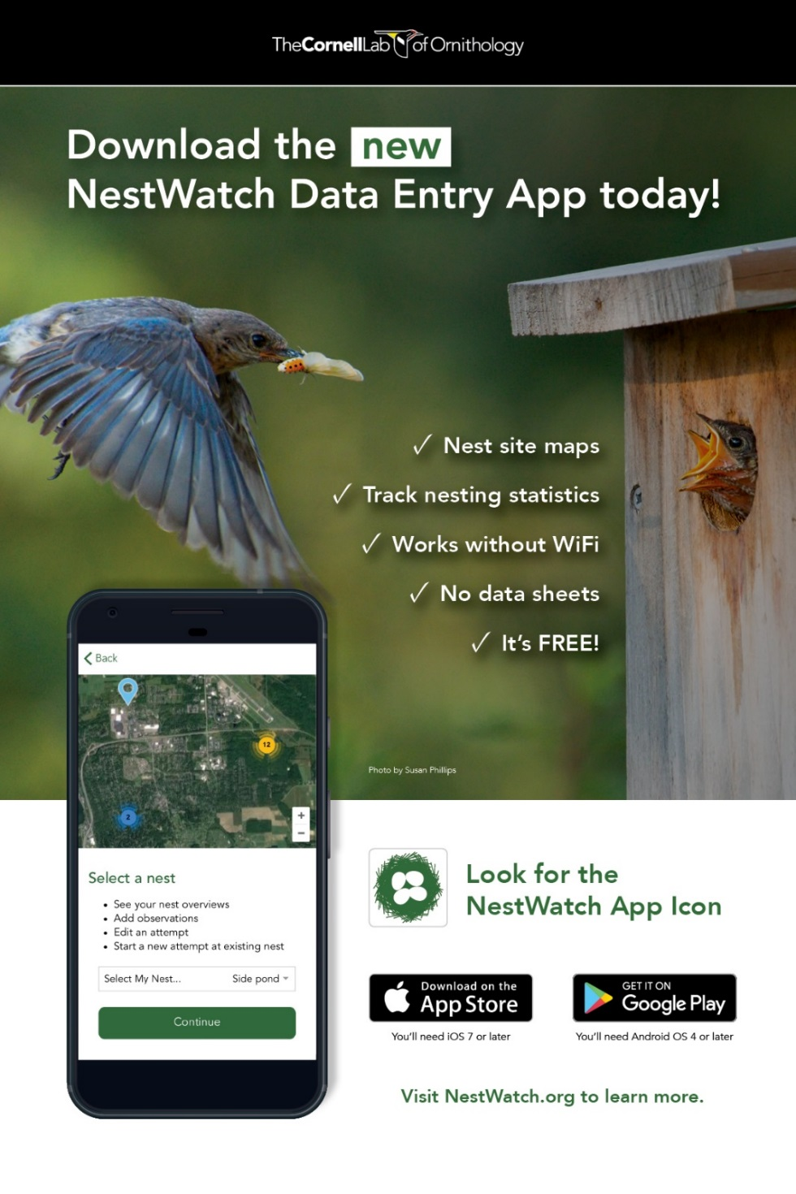
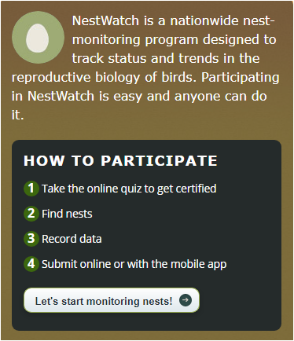
Notes:
It’s easy to participate.
Submit data online or with the mobile app.

Slide 29
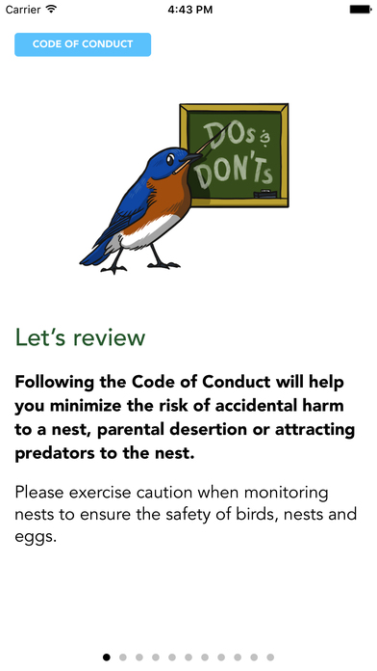
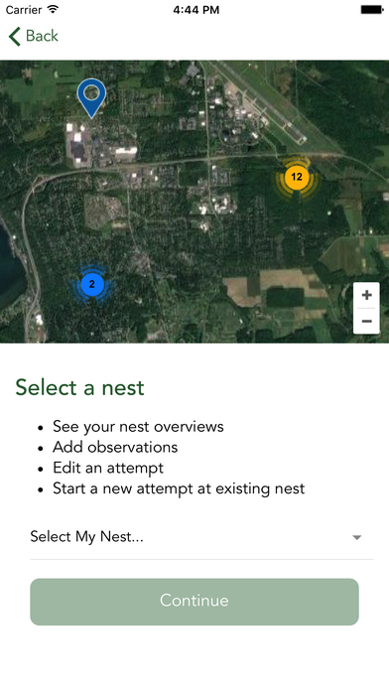
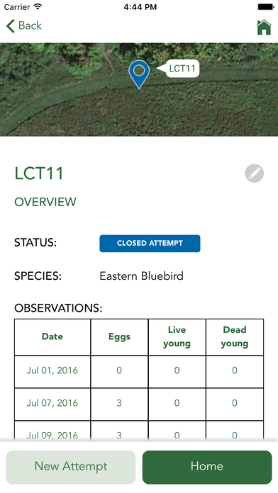

Slide 30
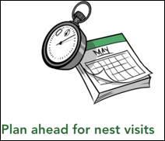
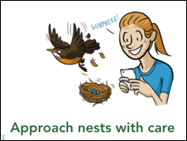
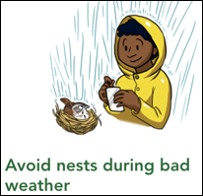
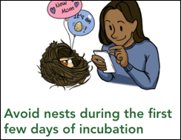
Do’s

Slide 31
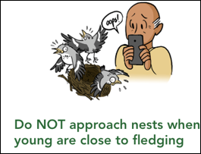
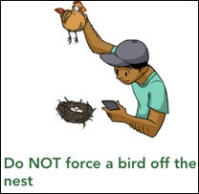
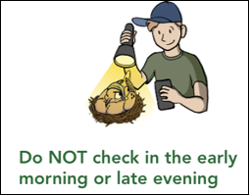
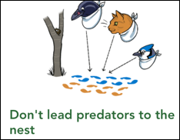
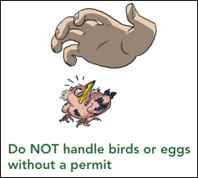
Don’t s

Slide 32
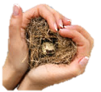
NestWatch in a nutshell
Tag the exact location of a nest you want to monitor.
Name your nest.
(Eventually) determine the bird species.
Observe if there are any eggs or young.
Move away from the nest to enter nest details.
Visit the nest every few days until the nesting attempt is completed.
Notes:
Tagging – this is an aerial view with Google Maps where you can see close up to click on exact location. If nestbox is in front of a particular tree in your front yard, you can see the exact spot.
Some people name their nestboxes after a relative or with a description of where the nestbox is placed (side yard south of driveway).
Eventually, when eggs appear or you see an adult, you can include the species.
A smartphone makes nest observation very quick.
A visit to a nest should take just seconds, definitely under a minute.

Slide 33
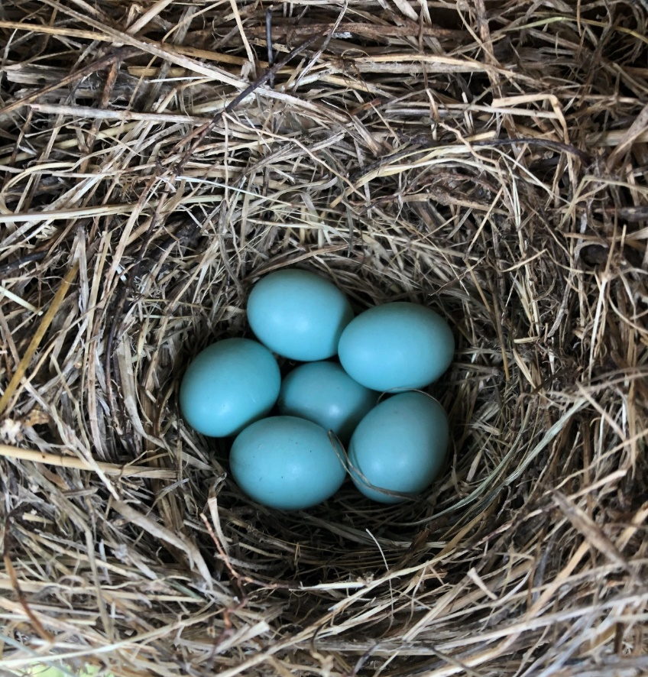
The up close and personal joy of observing bluebirds is so gratifying that it keeps monitors coming back year after year for a lifetime.
Jonathan Ridgeway

Slide 34
Bluebird Diet
Insects, Spiders, and other Arthropods
Berries
Notes:
If you want to attract bluebirds, you’ll need food.

Slide 35
Encourage Insects
Notes:
First thing you need to know … -
#1 No insecticides, if feasible. “Pesticides” kill insects.
Also avoid leaf blowers. Leaf litter is important for insect populations.

Slide 36
What “insects” do bluebirds eat?
Notes:
This is just a question. The answer falls on next page.

Slide 37
Primarily arthropod eaters:
grasshoppers
beetles
spiders
caterpillars
some mosquitoes (takes MANY for a meal
(mealworms)
Photo courtesy of
Mike & Jean Drummond
Notes:
Bluebirds feed mainly on insects, preferring to "swoop" down from a perch to a low grassy area to catch their food.
(BOW) About 2/3 of their attempts are successful.
They (normally) feed their nestlings nothing but insects. When very young, the nestlings are fed soft-bodied insects like this caterpillar.

Slide 38
Mealworms
Notes:
Mealworms are a favorite ! Consider them only a treat and feed sparingly, if at all. They’re for us. They provide humans a better look.
Quote from Dr. Patty Gowaty
“Supplemental feeding could be helpful, harmful, null. There are very few studies on the effects of supplemental feeding and no definitive answers yet.
Supplemental feeding allows the humans a better look. We aren’t saving bluebirds from extinction, but we may be inciting greater knowledge and appreciation of the natural world in the humans who put out nestboxes and supplemental foods.”

Slide 39
Notes:
Mealworms definitely furnish photo “opps”.

Slide 40
Notes:
Excuse me Aggies!

Slide 41
Notes:
Sometimes they eat amphibians! ☺

Slide 42
Native Plants for Bluebirds
Plants that attract insects
Plants that supply berries
Asclepias – milkweeds
Echinacea – purple coneflower
Lantana urticoides – native lantana
Liatris – gayfeather
Salvia farinacea – mealy blue sage
Cornus drummondii – roughleaf dogwood
Phoradendron leucarpum – mistletoe
Ilex vomitoria – yaupon
Phytolacca americana – American pokeweed
find many more on Texas Bluebird Society website. Search for Native Plants and Berries
Notes:
The plants listed here are just a few examples of native plants that will either attract insects for bluebirds to feed upon or plants that supply berries. The berry-producing plants are particularly important in the winter when insects are not abundant. A more complete list of plants is available on the Texas Bluebird Society website under the resources tab.
PRESENTER: if feasible, make a 2-sided copy with the two plant lists from Texas Bluebird Society website to distribute to audience members.

Slide 43
Plant for Insects
antelope’s horn
green milkweed
Asclepias – Milkweeds
Notes:
Some plants attract insects for bluebirds to eat. Milkweeds are particularly good plants for attracting insects.

Slide 44
Echinacea purpurea – Purple Coneflower
Salvia farinacea – Mealy Blue Sage
Liatris – Gayfeather
Native plants enhance your landscape as well as provide insects for bluebirds.
Notes:
Native plants can be beautiful to look at as well as furnishing insects for bluebirds.
Left: Echinacea purpurea – purple coneflower (Perennial)
Upper right : Salvia farinacea – mealy blue sage (Perennial)
Lower right: Liatris sp. – gayfeather (Perennial)

Slide 45
Rough-leaf dogwood Cornus drummondii
Flowering dogwood Cornus florida
Notes:
Dogwoods provide berries for bluebirds.

Slide 46
Phytolacca americana – Pokeweed
Cocculus parolinus - Carolina snailseed vine
Callicarpa americana - American Beautyberry
Ilex decidua - Possumhaw
Notes:
Pokeweed. (Phytolacca americana) It’s a herbaceous perennial.
Carolina snailseed vine. (Cocculus parolinus) This vine is a strong grower and should be used where its vigorous spreading nature will be appreciated.
American beautyberry. (Callicarpa americana) This native shrub is relished by many songbirds.
Possumhaw. (Ilex decidua) This small deciduous tree provides berries in the dead of winter.
Fruits are normally a very small percentage of their diet (5% - 25%, depending upon the where and the time of year.)
Before the fruit – blossoms. Blossoms attract _INSECTS.

Slide 47
Nuts and seeds?
Not with shells
Notes:
Sunflower hearts – but not sunflower seeds in shell.
Peanut butter suet does well.
Squirrels usually do not eat HOT pepper suet.
Find recipes for “suet” online looking for “peanut butter, oatmeal, lard”.
Purchase “suet” from stores like Wild Birds Unlimited, where it’s more fresh than “suet” at large chain stores.

Slide 48
Water
Notes:
Insects and berries provide water.
Bird baths should be shallow and clean.
Even frost between sidewalk bricks provides water.
Anytime you see several males together, it’s not breeding season. This photo was taken in winter.

Slide 50
From Courtship to Family

Slide 51
Notes:
Back to nestbox – for all practical purposes, the nestbox is for laying eggs and raising babies.
The nestbox is not a house for living. Bluebirds might roost in wintertime on very cold nights.
Males, sometimes accompanied by female, scout for cavities, usually months before nesting season begins.
(***BOW) In areas where bluebirds overwinter (for instance, Texas) … nestboxes placed out in October, when the size of the local population is at its peak (due to influx of migrant bluebirds), attract new bluebirds into a potential nesting area.

Slide 52
Notes:
The male entices female(s) with a demonstration that will include the “wing wave” and singing. She’s so happy she’s dancing!
PRESENTER: before playing sound, learn how to stop the sound.

Slide 53
Notes:
The male’s courtship behavior includes feeding his mate.

Slide 54
Notes:
The male may lead the female to several nesting sites

Slide 55
Notes:
…with the female usually making the final choice. “Hey Hon! Take a look at this one!”
(**BOW) “Pairs are bonded once female enters the cavity with the male for the first time.”
Note: There are no hard and fast rules with bluebirds. Individual bluebirds are extremely different, even in close locales. Because your bluebirds always behave in a particular way, does not mean someone else’s bluebirds will ever behave in that way.

Slide 56
Notes:
(***BOW) “The female alone builds over several days, after gathering material usually from the ground. …
The male may bring some nesting material.
(***BOW) For the first nesting, it may take up to three weeks to build the nest. In subsequent nestings, nests may be completed in less than one day.

Slide 57
Notes:
(**BOW) Reports of male assistance with nest-building probably mistakenly based on observations of males carrying nesting material.”

Slide 58
Notes:
It’s enjoyable to watch the male assisting the female during nest building.

Slide 59
“The distribution of housework did seem a bit typical.
She flew full speed for three hours. He watched!”
Dr. Shirl Brunell
Notes:
Presenter: Please show slide for just a few seconds to give audience members time to read.

Slide 60
Notes:
Nest is usually fine grasses … or pine needles. (I’ll show you a grass nest photo in a minute.)
Might add or use other materials – such as pecan catkins.
Sometimes nest is course grasses .
Even retama leaves may be used. (Native tree: Parkinsonia aculeate)
When nesting material is discovered, start gathering observations for NestWatch.org. Observe and report nestings about twice a week on NestWatch, either using the NestWatch app or on the website.. Your data on nestings will be added to those of thousands of other NestWatch’ers in a realtime and continually growing database used by researchers to understand and study birds.
Once the nest is built, do not monitor in morning, during the days she may be laying eggs. (***BOW) Eggs may be laid as early as dawn and as late as 11am.
Too, many mornings early in season are too cool for nestlings to be exposed.

Slide 61
Notes:
Courtship leads to copulation … when she‘s ready. This female is not ready. Successful fertilization of eggs depends on her cooperation. Copulation is by a cloacal kiss: the meeting of the cloaca of male and female.
***BOW: Copulation is completed in 1 -5 seconds.
***BOW: Copulation begins as many as 8 days before first egg is laid, and continues to as many as 6 days after the first egg is laid (with one egg laid each day). Once first egg is laid, many times copulation occurs within an hour.
***BOW: Generally Eastern Bluebirds are socially monogamous, but DNA has proven that extra-pair copulation does occur (in some studies, 20 - 35% or more eggs are by one or more males.)

Slide 62
Notes:
***BOW: Egg-laying begins as soon as the nest is completed, up to 3 weeks later
Female will lay one egg per day – dawn to 11am.
In Texas, first reported eggs typically occur in February. With 2 – 4 clutches per year, some eggs are laid in August.

Slide 63
No need to pull nest to reveal what’s there.
Notes:
To secure the data and check for any problems (to “NestWatch”) you’ll need:
a pad and paper OR smartphone OR memory (if you have one nestbox!);
a long-handled mechanic’s mirror OR a small digital camera OR a smartphone (even with a selfie stick) – in order to quickly see what’s in the nestbox without disturbing the nest.
There is no need to pull nest to reveal what’s there.
With mirror or a quick photo, there is no possibility of a broken egg. The eggs are fragile. If eggs of a chickadee or titmouse are covered with hair or soft materials, you could lift hair or soft material … but, you can also just wait until the next visit.

Slide 64
Notes:
Take-your-breath-away bluebird egg blue
***BOW: a total clutch size is 3 to 6 or 7 eggs
A small percentage of bluebird eggs are white (In one study in AL, 2% were white and 1% pink). The color of the egg makes no difference in the color of the babies!
***BOW: Incubation lasts 11–19 days, generally 14; summer clutches may have shorter incubation periods than earlier clutches.
***BOW: Female usually remains on nest all night; she’s away from nest longest in first hour after daybreak. In Texas … she’s also away in the heat of the afternoon.
***BOW: Unincubated eggs often remain viable through extended periods of low temperatures. Do not remove a nest just because eggs have not hatched after several weeks.

Slide 65
Notes:
Excuuuuuse me !! If she remains on nest even after you’ve knocked on nest, close door and return later.
(Facts from ***BOW, Birds of the World)
What time of day do eggs hatch? Many eggs hatch in first 2 hour after dawn, but they may hatch at any time of day.
How long does it take for an egg to hatch? Duration of hatching/egg varies: 1–6 hours from pipping to full emergence.
How long does it take for the clutch to hatch? Sometimes 20 – 30 minutes for entire clutch; usually within one day. In late summer, may take two days.

Slide 66
Notes:
This shows the developmental progression once the eggs are hatched.
**BOW: About 83% of eggs laid hatch, and 75–90% of hatchlings fledge.
About 20% - 25% of songbirds survive the first year.
***BOW: Eyes open on days 5–6.
Nestlings can maintain body temperature at about 7–8 days of age
By day 9, can crawl.
By day 12, almost completely feathered.
By day 13, can be assigned reliably to sex.
In a little over two weeks, the babies “fledge”.
***BOW: Fledging age, like clutch size and incubation time, varies with latitude and resource availability.
16 – 18 days is quite typical in Texas.

Slide 67
Notes:
Both parents will bring food to the young, starting the first hour after hatching. When 3 – 4 days old, each nestling is fed about 1.5 times /hour. By day, 9 – 11, each nestling is fed over 2 times each hour.
When first hatched, soft insects are brought. The male will be especially active in feeding during the first 5 - 7 days while the female is “brooding” (sitting on nestlings to keep them warm, since they are born unable to regulate their body temperature.)

Slide 68
Notes:
Sometimes, when nestlings are older, they might bring very large insects! (This is dad. …. Maybe she’s out shopping.)

Slide 69
Notes:
Another sure sign of hatchlings.
Disposable diaper.
***BOW: Nestlings often defecate after delivery of a food item. Adults often wait for nestlings to turn and present the fecal sac to the parent;
Fecal sac is removed by the adults and dropped 20 – 110 yards from nest.
Linda Crum has observed one female placing the sacs in a line on a pine tree limb. A little OCD?

Slide 70
Notes:
Sure sign about time to “fledge” (leave nest for first time)
When the babies start jumping up and down, and poking their heads out of the entrance hole, they will fledge within a few days.
Bluebirds in Texas will fledge from 16 to 20 days after hatching.
**BOW: As fledglings leave the nest, they give Tu-a-wee call, and fly to a perch or to cover, up to 30–50 yards away

Slide 71
Notes:
Dave Kinneer captured what few bluebird enthusiasts see, babies "fledging," flying from the nest.
This was an unusual happening, with all fledglings leaving the nest one after another. It may be several minutes between or even up to a day for the full clutch to fledge.

Slide 72
Notes:
***BOW: Fledglings typically remain in or near cover for first 7–10 d after departing nest.
Parents will take food to fledglings.
Use binoculars to follow bluebird with insect to see where babies are hidden.
For Eastern Bluebirds, rarely the young from first nesting will help tend to subsequent nestings.
***BOW: Interval between fledging of 1 brood and laying of the next is typically about two weeks; however, it can be as longer. It can be closer. Also, sometimes a female will start a subsequent nest in another cavity while still feeding nestlings .

Slide 73
Notes:
After fledge, it time to go back to NestWatch.org to summarize the record of the nesting. Create a new record in NestWatch for each nesting.
Removing the nest is TBS’ “best practice”, so nests do not build up close to the hole. You need not wear a mask.
Be ready for the process to begin again. Bluebirds have two – four nestings in a season in TEXAS.

Slide 74
Notes:
With Eastern Bluebirds, youngsters typically do not help with nestings later in the season. They’ll learn to eat from parents and stay in family group.

Slide 75
Notes:
When the juvenile bluebird molts, it takes on the plumage of an adult. After wintering in family group, the first year Eastern Bluebird may start courtship and a family.

Slide 76
People who are willing to spend the money or take the time to build good nestboxes, install mounting poles with guards, and then take the time to monitor and learn more about the lives of these birds, are Extra Special human beings.”
Keith Kridler
Notes:
PRESENTER: You might show this slide for a few seconds. Do not read to your audience the words that appear on screen. It’s TOO long. You might say, “Helping Bluebirds … Extra Special human beings”

Slide 77
Competitors, Predators, and other Hazards

Slide 78
House Sparrow
#1 Competitor and Predator
Notes:
Photo from Bluebird Monitor’s Guide.
We’ll save the worst for the last. Remember this. Even if you decide not to join the bluebird conservation effort, please do not allow the non-native House Sparrow to nest. It’s alien, and it’s destructive to our native species – just as imported fire ants destroy native species.
Avoid feeding wild bird seed with millet, which attracts sparrows. Plug the holes of decorative birdhouses and other spots where you find them nesting.
If you have strong population of House Sparrows, consider a hole restrictor that will allow titmice, chickadees, and wrens, which are smaller than bluebirds and House Sparrows (search online for metal “portal”, 1 1/4 -inch or 1 1/8 inch hole,

Slide 79
Notes:
Often the first sign of a House Sparrow’s presence is the sight of the male sitting on the nestbox.
Or, it could be opening the nestbox to find a voluminous nest with grasses and weed and a nest cup in a tunnel.
BUT, Be cautious in removing loose grasses. The start of a bluebird nest can be very similar to a House Sparrow nest.
When eggs appear, they vary greatly in color and speckles.
You might remove the eggs from the nest and spray with vegetable oil spray. Once the eggs are returned to the House Sparrow nest, they will not hatch and many House Sparrow females will continue to sit on the eggs for weeks.

Slide 80
Warning: Next slide is gruesome

Slide 81
30 minutes later …
WARNING
Do not put mealworms at nestbox.
Notes:
Thirty minutes before, the bluebird was eating mealworms. Then, a House Sparrow entered the nestbox and attacked.
And, the resulting carnage is what you see.
(By the way, feeding a bluebird mealworms at the nestbox can attract predators and cause fights with other avian species. If you feed just a few and if you watch to make certain that would probably be no problem.)

Slide 82
Notes:
House Sparrows sometimes kill an adult native songbird on the nest and build their nest over the dead bird.
Not all House Sparrows kill bluebirds; but, many individuals have found they cannot have a successful nesting of any native species if House Sparrows are active.

Slide 83
CONSIDER

Slide 84
If House Sparrows show up after a native nest is built . . .
www.sparrowtraps.net/sparrow-spookers
Mylar balloon strips thumbtacked
Notes:
A Sparrow Spooker protects nestings from House Sparrows AFTER the first bluebird egg is laid. This whirligig contraption with Mylar strips that flap in the breeze is added to the nestbox. Bluebirds (and other species) will go in and out to their nest (just watch to make CERTAIN your birds accept the Sparrow Spooker … the next afternoon you should find a 2nd egg.) But, House Sparrows nearly always stay away. IMPORTANT: Remove the device when the babies fledge – so the House Sparrow does not become desensitized. Reinstall Sparrow Spooker on subsequent nestings after the first egg is laid. Replace Mylar strips each year, since they become dull.
If you use the TBS nestbox with flat overhanging roof, you might first try attaching Mylar balloon strips to the edge of the roof on either side of the hole with thumbtack.

Slide 85
If House Sparrows show up before a native nest is built . . .
Universal House Sparrow Trap
https://vanerttraps.com
Notes:
Mounting screws for the Van Ert House Sparrow Trap are installed in the official TBS nestboxes below the entry hole. The Van Ert Trap can be purchased online, www.vanerttraps.com Using the trap requires monitoring every 30 minutes. READ INSTRUCTIONS!
If you have observed House Sparrows, you might order a VanErt Trap now to be prepared.

Slide 86
Release bird into bag for identification
Notes:
When trapped … dispatching the House Sparrow is the most effective action.

Slide 87
Trim outer tips of wings
Notes:
If you cannot take the life of a sparrow (maybe you don’t kill roaches) … you might trim the “primaries” – the outer tips of the wings. The House Sparrow may become part of the food chain. For the current nesting season (until the bird molts), the House Sparrow cannot fly to a nestbox.

Slide 88
“Trapping House Sparrows is like mowing your lawn. You can not expect to have a pretty yard if you only mow once a year!”
Keith Kridler

Slide 89
CATIO
Notes:
Feral cats and house cats allowed outside kill bluebirds. Some cats can jump six feet up to the top of a nestbox.
A “catio” brings pet cats outdoors without endangering birds.

Slide 90
Notes:
Squirrels sometimes predate nestboxes if they access by jumping from a tree branch or climb an unbaffled pole.

Slide 91
Notes:
The most common mammalian predator is the raccoon.
Road kill used for demonstration – not a trained Raccoon !

Slide 92
Notes:
Kingston Predator Baffle helps deter (not prevent) “critters” (mammalian predators and some snakes). This wobbling 8-inch cylindrical baffle is much more effective than cone baffles or baffles with less diameter. It was designed to clang against the pole.

Slide 93
Notes:
Some snakes can climb vertical surfaces with ease !
To capture the snake, a hoop trap can be made with wire and a “tutu” of bird netting.
But ….. then, you must deal with the captured snake.

Slide 94
Notes:
Place mounting poles far enough away from fences to prevent animals from jumping to the nestbox .
In this photo, snakes were prevented from going up the pole by painting PVC sleeve with thinned axle grease.

Slide 95
Fire ants ARE a problem in Texas.
Tree Tanglefoot® Insect Barrier
Notes:
Apply a ribbon (about ½-inch) of a sticky substance on the pole under baffle – the best is Tree Tanglefoot Insect Barrier, a nursery product that is not longer readily available. By Summer 2023, it skyrocketed in price to about $30 on Amazon.
A less pricy product TBS has not tested is Catch ‘Em.

Slide 96
Notes:
Rubbing a bar of Ivory soap inside the roof and upper portions of nestbox will leave a residue that makes it difficult for wasps to add a nest.

Slide 97
Texas Heat can kill babies and destroy eggs
Notes:
Heat is a hazard in Texas.
Effective ways in this study to reduce the heat inside nestbox were: paint a light color and/or add HeatShields.
Look! Within a weathered nestbox, the heat inside on a 92.3 degree day soared to almost 109 degrees.
As a result of this study, TBS increased the vent size of our official nestbox to 5/8-inch from ½-inch.

Slide 98
HeatShields
in an emergency
Notes:
HeatShields help reduce the temp inside the nestbox by airflow through the spacing between the box and shields. These can be made from the back side of political signs or PVC flat trim moulding. (find specs for HeatShields on TBS website.)
Some bluebird landlords have provided shading for nestlings with a canopy on extremely hot days.

Slide 99
Prevent hole enlargement (squirrels, woodpeckers) with metal portal.
Prevent damage to bird feathers by sanding rough holes.

Slide 100
Blowflies are NOT a problem in Texas.
Notes:
Blowflies are not a problem in Texas for Eastern Bluebirds.
There is no need to take any special precautions.

Slide 101
Manmade hazard:
You can prevent deaths.
Nestlings trapped in vertical pipes perish.
Cover open vertical pipes to prevent this tragedy.

Slide 102
Native Secondary Cavity Nesters
Notes:
These native cavity-nesting birds might nest in a “bluebird-sized” nestbox. They are placed in order of the Conservation Priority established in 2012 by Partners in Flight. This presentation has 2020 numbers. Every single species in the sequence has a greater conservation priority than the Eastern Bluebird. When you install a “bluebird nestbox”, you provide an element of habitat needed by many species.

Slide 103
ALL native birds are desirable.
Notes:
NOTE TO PRESENTER: Hide slides of bird species that are not native in your region of Texas.
Some people call a system of nestboxes, a “bluebird trail”. We say, “nestbox trail”.
Our nestboxes are for ALL native cavity-nesting birds.
Federal law forbids removing nests of native songbirds.
ALL native birds are desirable. ALL native birds are desirable. ALL native birds are desirable.

Slide 104
Prothonotary Warbler
7th
of 63 native cavity-nesting birds in North America
2.1 million
Notes:
Prothonotary Warbler
Only 2.1 million according to 2020 Partners in Flight estimates / Ranked 7th in Conservation Priority.

Slide 105
Brown-headed Nuthatch
12th
1.6 million
Notes:
Brown-headed Nuthatch – Use a 1 inch hole reducer on box. 1.25 is too large. Other cavity nesters such as Tufted Titmouse or Carolina Chickadee (and even Eastern Bluebirds) may evict the Nuthatch and build their own nest on top.
1.6 million estimated population.
Ranked 12th in Conservation Priority

Slide 106
Black-crested Titmouse
27th
1.2 million
Notes:
Black-crested Titmouse.
Only 1.2 million. Ranked 27th in conservation priority

Slide 107
Notes:
When a Black-crested Titmouse or other smaller cavity nesting bird nests in a “bluebird nestbox” temporarily add a metal portal to prevent bluebirds from usurping the smaller bird’s nest.

Slide 108
32nd
7.9 million
Bewick’s Wren
Notes:
Nest uses twigs and leaves with some grasses.
7.9 million Bewicks Wren.
32nd in Conservation Priority.

Slide 109
Carolina Chickadee
35th
13 million
Notes:
Carolina Chickadee. Only THIRTEEN MILLION. Ranked 35th in Conversation Priority.

Slide 110
Ash-throated
Flycatcher
45th
10 million
Notes:
Ash-throated Flycatcher.
Only 10 million.
Ranked 45th in Conservation Priority.

Slide 111
Tufted Titmouse
48th
12 million
Notes:
Tufted Titmouse
12 million
48th in Conservation Priority

Slide 112
Carolina Wren
Carolina Wren
57th
19 million
Notes:
Perhaps you’ve had a Carolina Wren nest in a wreath on door?
This loud little songbird will sometimes use a bluebird nestbox.

Slide 113
Tree Swallow
19 million
Notes:
Texas has a small population of Tree Swallows.
In Texas, Tree Swallow nests primarily along Red River and reservoirs along eastern border.
One TBS member had a Tree Swallow nesting out from Fort Worth, near Lake Benbrook.
The nest is usually lined with white feathers and the eggs are white.
Should you have a Tree Swallow nesting in a nestbox, remember to report on NestWatch and kindly send photos to Texas Bluebird Society (editor@Txblues.org)

Slide 114
ALL native birds are desirable.

Slide 115
in closing …

Slide 116
Eastern Bluebird
58th
23 million
Notes:
Remember?
Eastern Bluebirds are not endangered or threatened. They are well established as a species after being in decline.
According to Partners in Flight 2020, 23 million Eastern Bluebirds
Ranked 58th of 63 cavity nesters in Conservation Priority.
People putting up nestboxes have increased the number of bluebirds and spread them to new areas … and new backyards.
And, they’ve brought tremendous delight to humans.
Will you join Texas Bluebird Society in spreading “Bluebirds Across Texas…one nestbox at a time” ?

Slide 117
“The last chapter of bluebirding has not been written.”
Pauline Tom
Founder and Past President,
Texas Bluebird Society
Notes:
We’re not done yet!

Slide 121
We have some extra photos for presenters to insert into presentation if needed.
If you need help, contact execs@txblues.org

